Slide 1

CIS 512 Final PROJECT
Ames Housing Data
By Vipul Arora

Slide 2
Introduction
This is a housing data which contains data of houses sold from 2006 to 2010
We will study about different houses within AMES city
There are many factors that could affect the sales price of the house.
We will study about Houses from the provided dataset and The attributes having affect on the sales price of the house.

Slide 3
Analysis Part 1
Exploratory Data Analysis

Slide 4
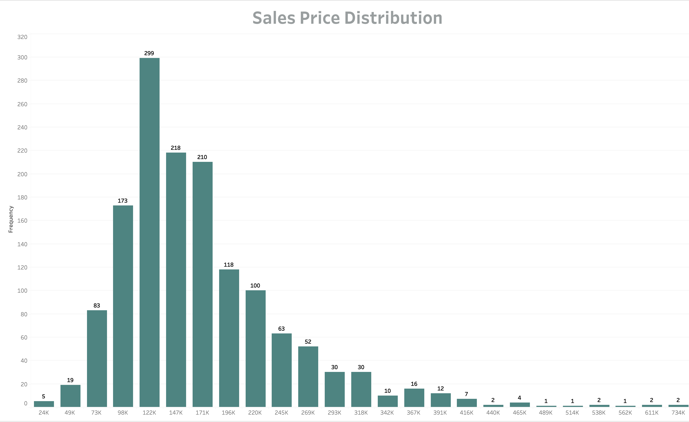
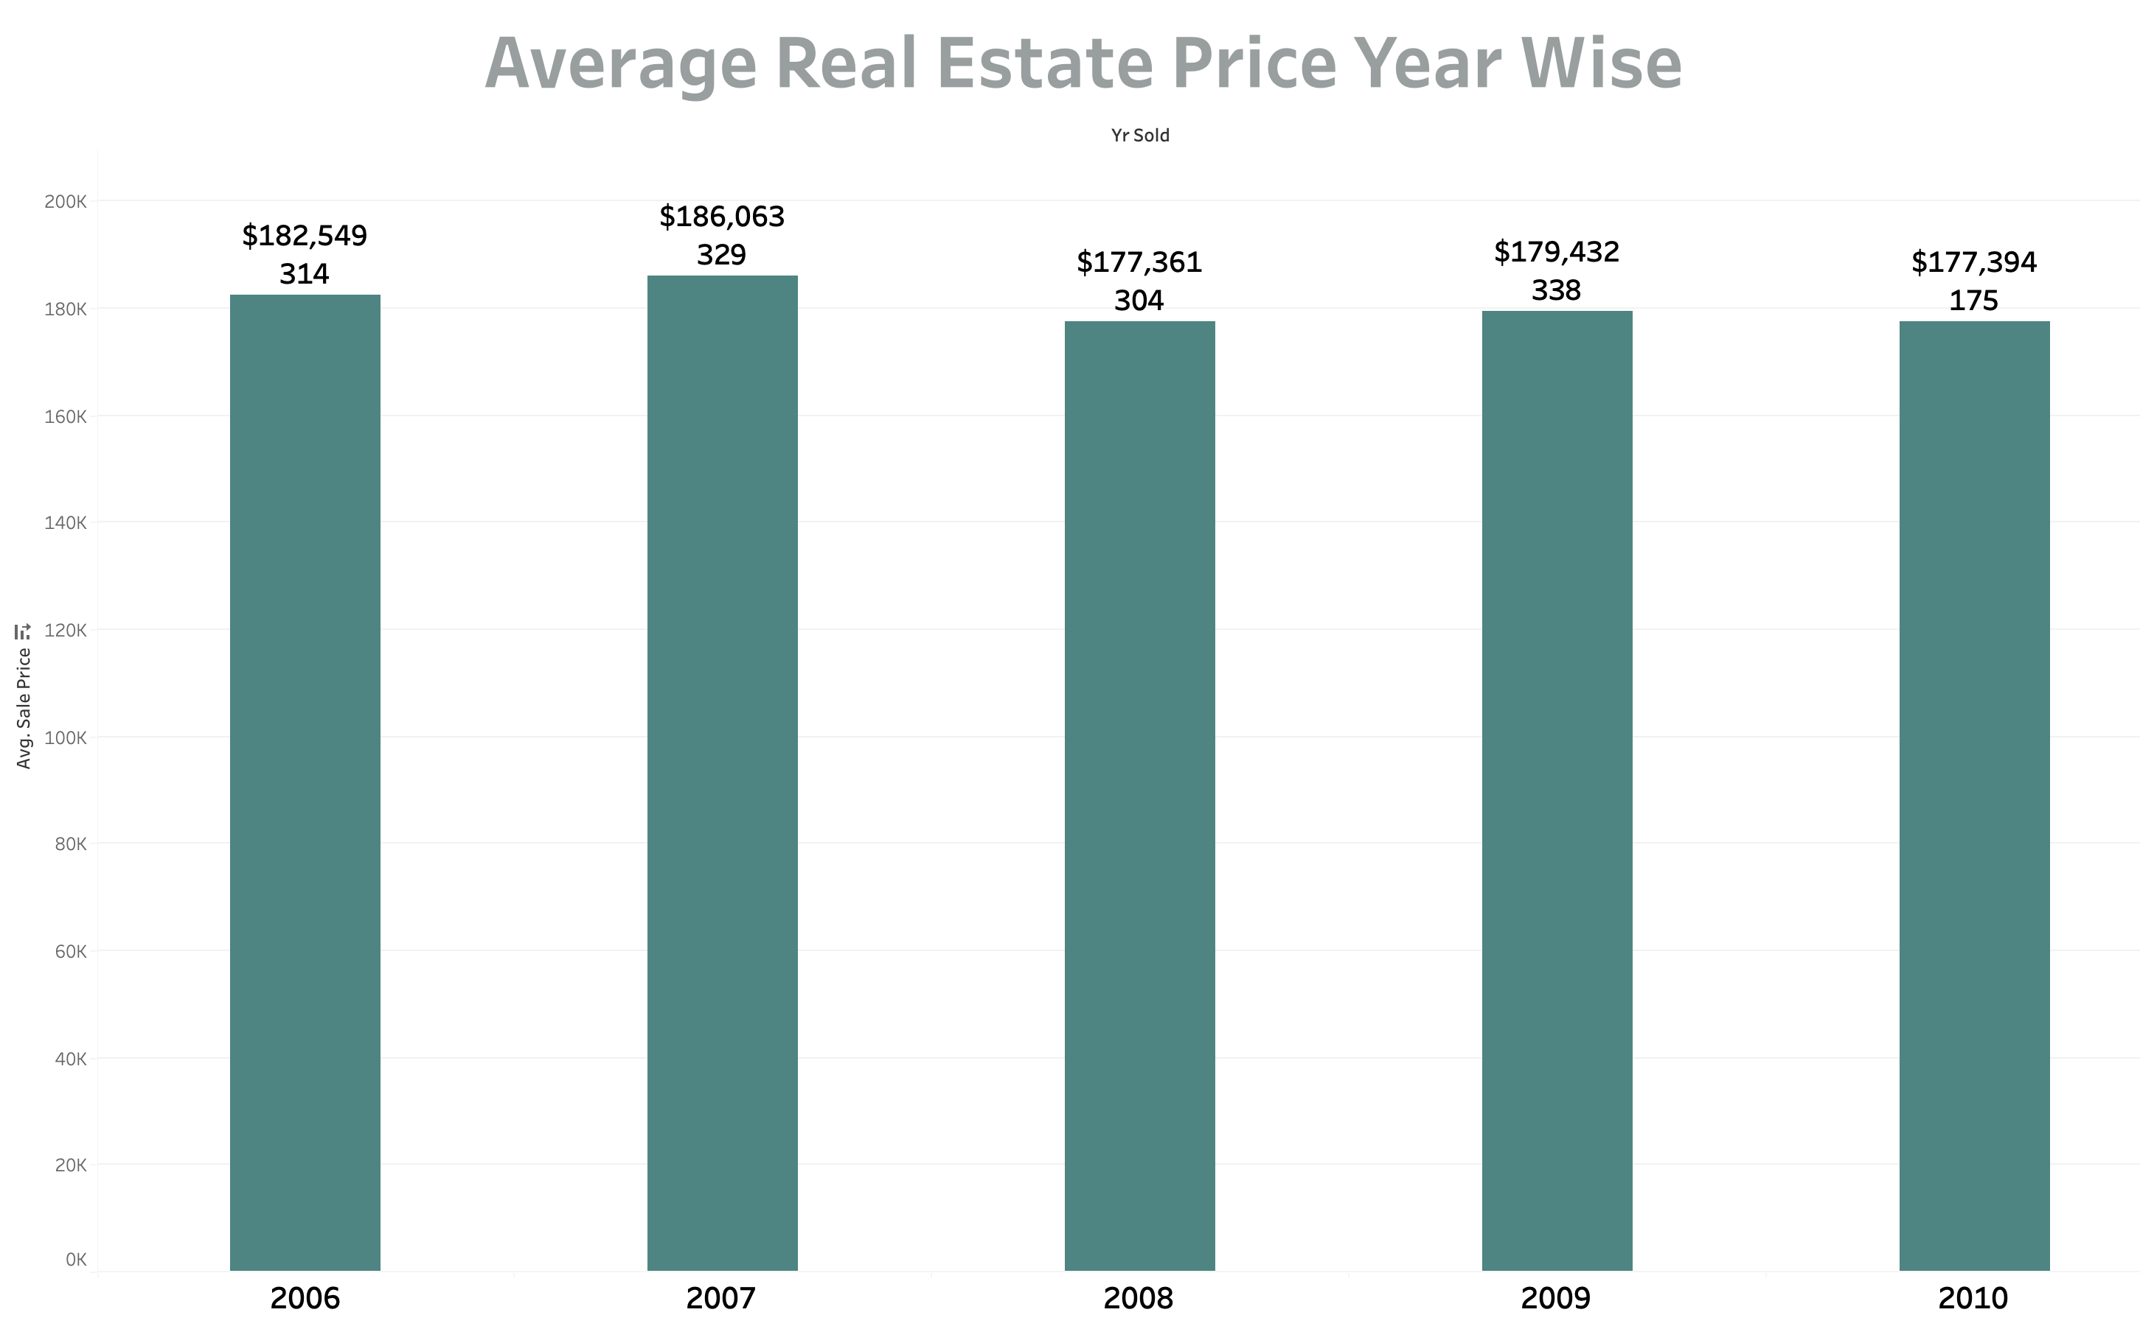
Ames housing data at a Glance
count 1460.0
mean 180921.1
std 79442.5
min 34900.0
25% 129975.0
50% 163000.0
75% 214000.0
max 755000.0
Notes:
Our 92 of our data lies btw 73k to 318k
most of them lies btw 120 to 170
In 2009 max houses were sold ,price droppd in 2008 and 2010

Slide 5
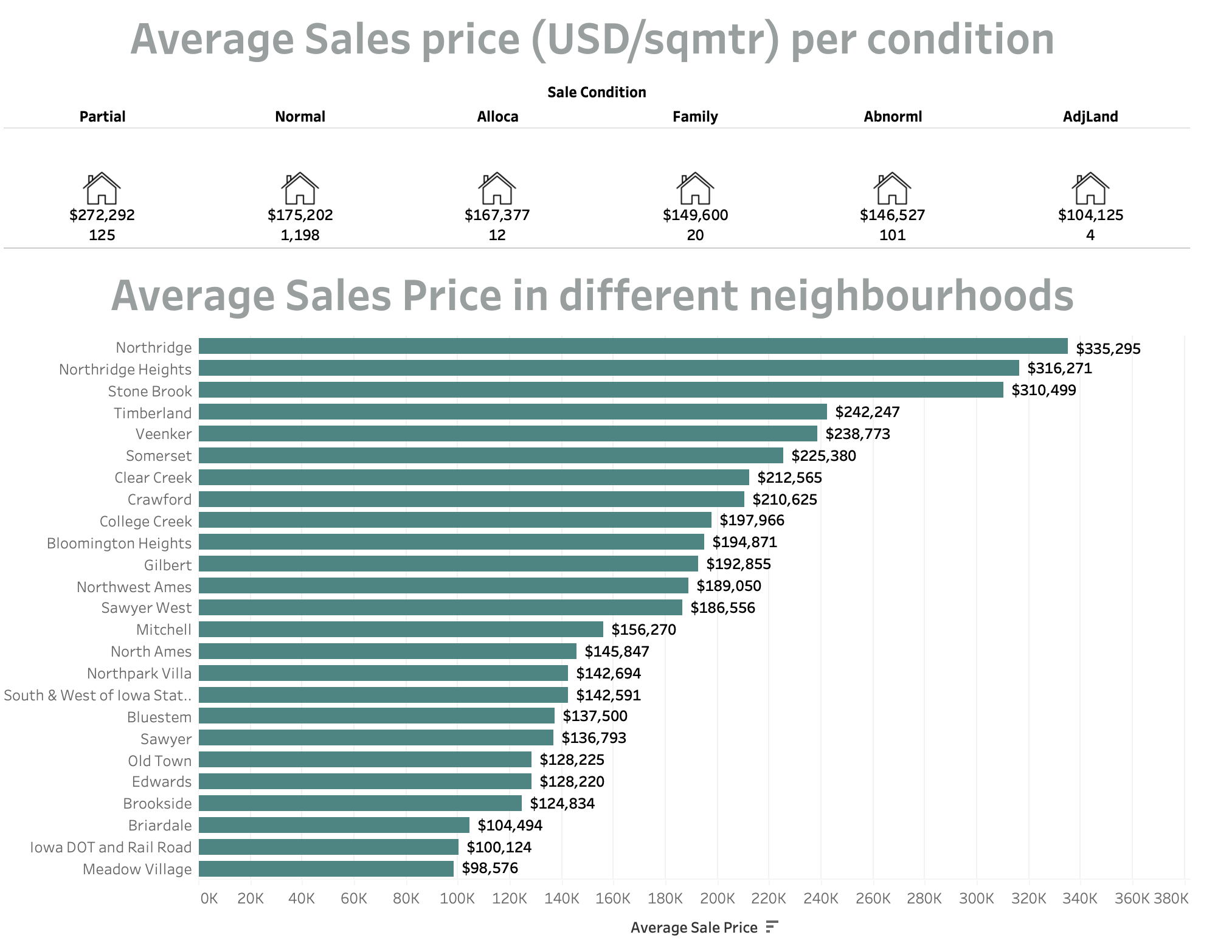

Ames Housing Dataset at a glance
2.12 %
Of real estate are family Condos
2.95%
Of real estate are
Town Houses
83.56 %
Of real estate are family Houses
3.56 %
Of real estate are Duplex Houses
7.81 %
Of real estate are Townhouses E
Notes:
Here is a snapshot of Ames Housing Data
Majority of the houses are family houses accounting for 83.56% of the total housing stock and the least are family condos with only 2.12 %.
Noridge, Noridge heights and Stone Brook are most expensive neighbourhoods and meadow village has the least expensive sale price followed by Iowa dot.
There is a considerable price drop around 50k from stone brook to timberland.
Also, we see that majority of the houses i.e. 1198 are in normal sale condition and the sales price is commanded by partial sales.

Slide 6
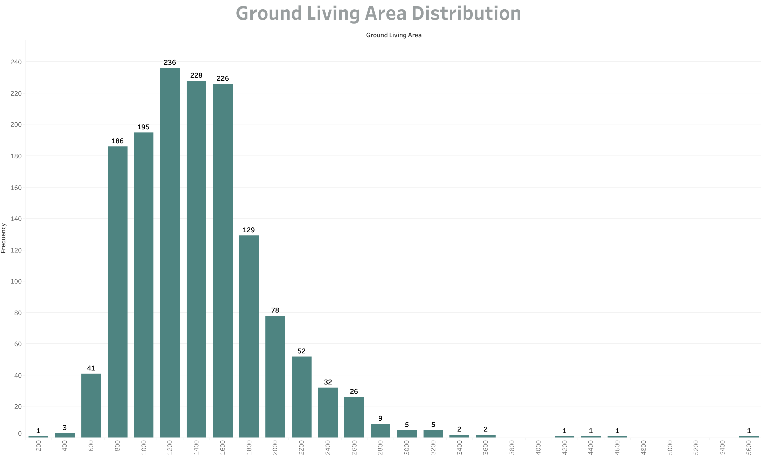
count 1460.0
mean 1515.4
std 525.4
min 334.0
25% 1129.5
50% 1464.0
75% 1776.7
max 5642.0
Notes:
95 % of the properties lies btw 600 to 2600 sq.ft. and with in this Most of the properties are btw 1200 to 1600

Slide 7
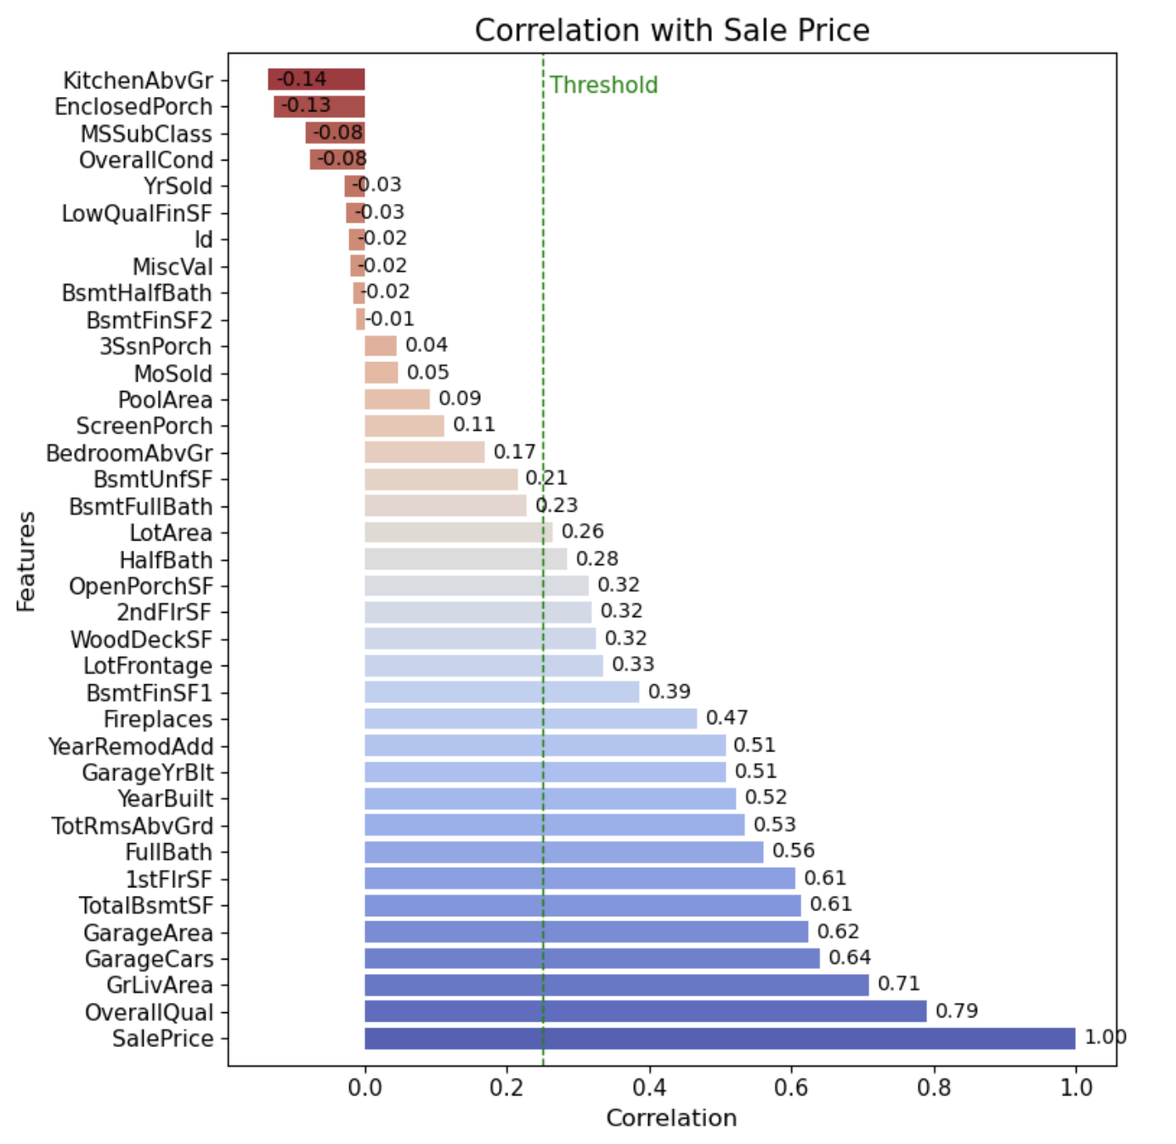
Factors influencing the Sales Price Correlation with Existing Attributes
Dimension 1: House overall condition:
Year Built, Overall Quality, Year Remodeled
Dimension 2: House inside condition:
Grade Living Area, Total Rooms , Bathroom, Fireplace, air conditioning
Dimension 3: House outside condition:
Garage Area, External Quality, Garage Cars, Pool Quality
Dimension 4: House community environment:
Neighborhood, House Style
Notes:
Under this section, a regression analysis was performed in order to find out the predictors of house sale prices in Ames, Iowa.
These are 4 dimensions of house characteristics that have already been shown to be correlated with sale price

Slide 8
Custom Columns Added to the Dataset
OA2
TotalGrBsmtSF
GarageArea
MasVnrArea
Total Rooms
TotalBathrooms
BedroomAbvGr
KitchenAbvGr
Total Bathrooms
Total Bathrooms in Basement
BsmtFullBath
0.5 BsmtHalfBath
Total Bathrooms above ground
FullBath
0.5(HalfBath)
Total Finished Area
FinishedBsmtAreaSF
GrLivArea
YearBuilt
Age
YrSold
Year
RemodAdd
Remodel Age
YrSold
Notes:
Animate this and one at a time
Other are 2 mention that
Total Room should be highlighted
Age should be in solid green

Slide 9
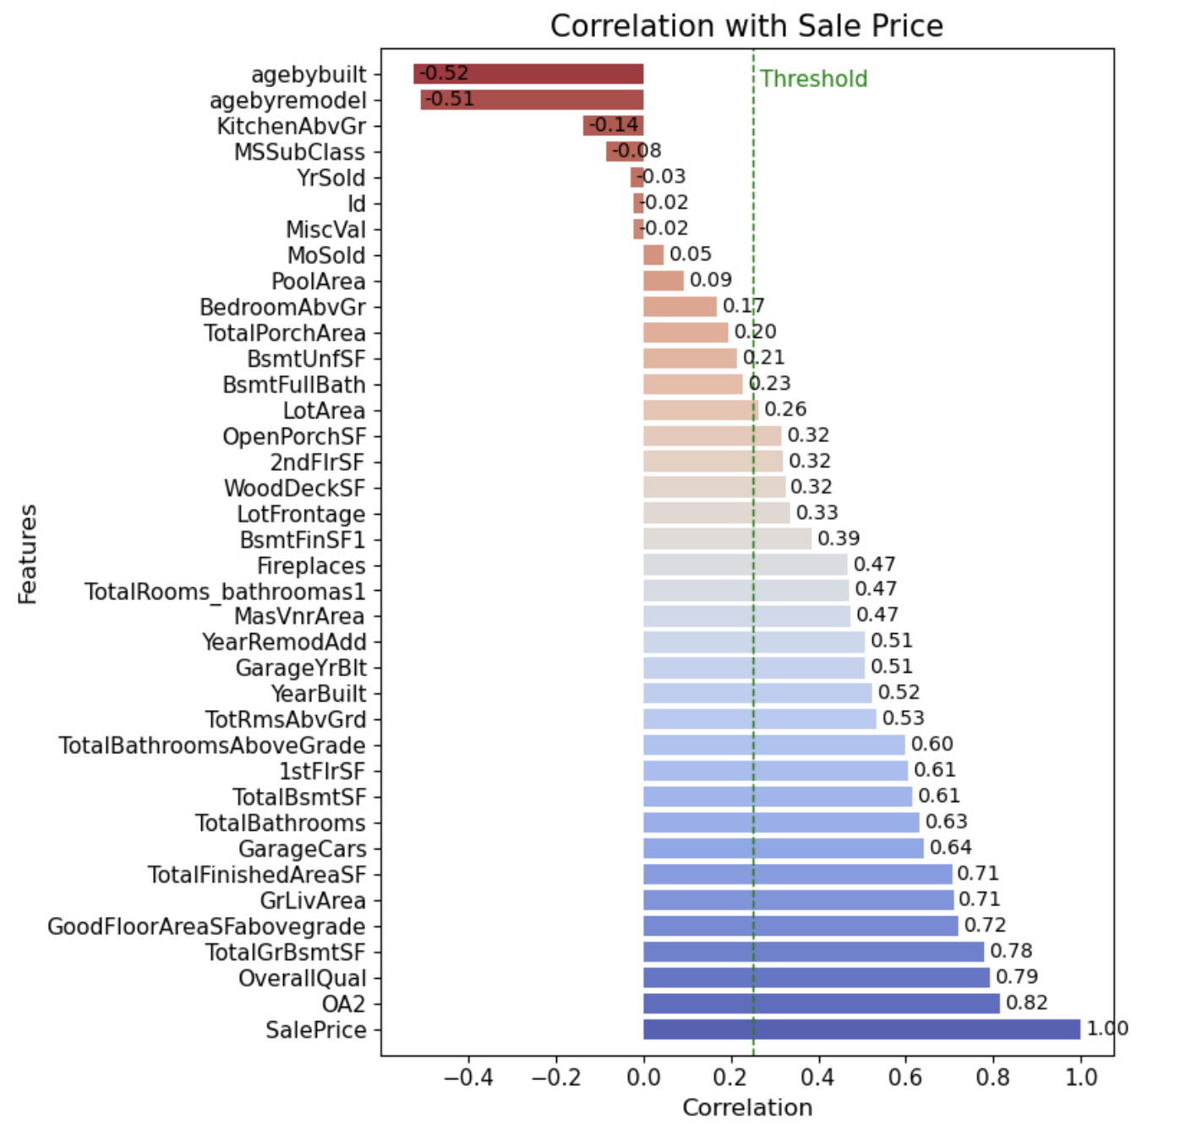
Correlation of Sales Price after adding Custom Columns
Columns Added
Total Bathrooms in Basement
Total Bathrooms above ground
Total Bathrooms
Total Rooms
Total Porch Area
Finished Basement Area
Total Finished Area
Age of house
Age of Remodelling
Other area 2

Slide 10
Dimension 1
House overall condition

Slide 11
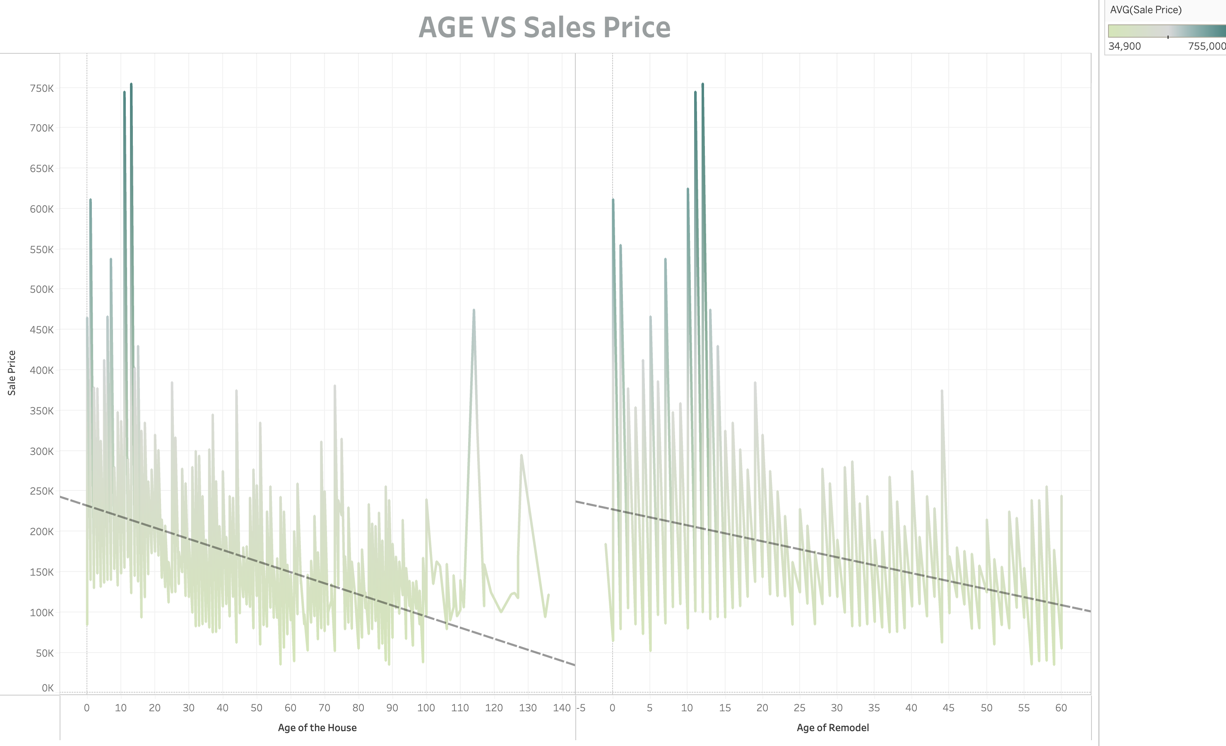
Notes:
Age has a negative correlation with Sales price. The average sales price of houses decreases as they get older.
There is also a cluster of points at the far right of the graph, which represent houses that are over 100 years old. These houses tend to be more expensive than other houses of the same age, likely due to their historical significance or their unique architectural features
Overall, the trend line in the image suggests that the age of the remodel is a significant factor in the sales price of a house
Buyers are willing to pay a premium for houses with newer remodels, but they are not willing to pay a significant premium for houses with very old remodels.

Slide 12
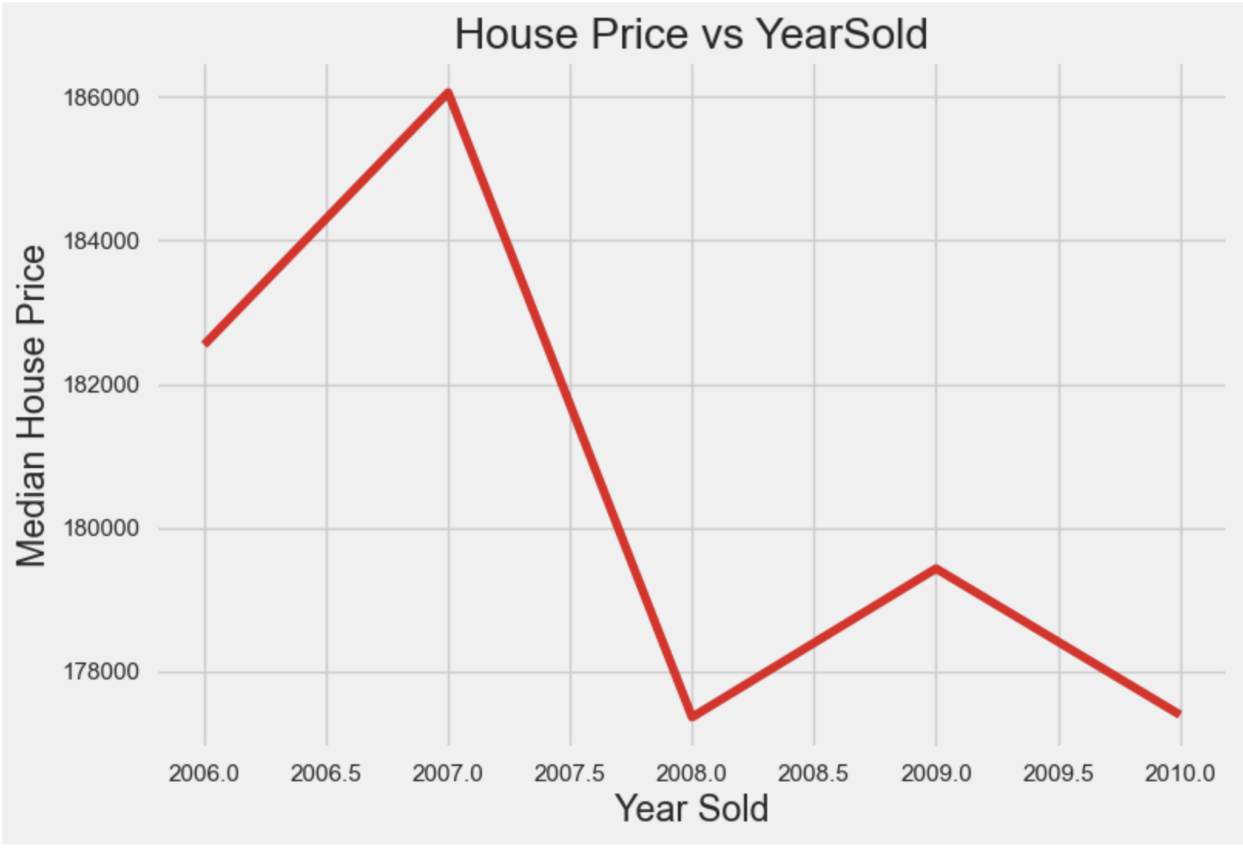
The 2008 recession led to a notable housing price decline due to reduced demand and economic conditions.
Notes:
Economic conditions also have an impact on the sales price. In this graph, we see that recession led to decrease in the sales price.

Slide 13
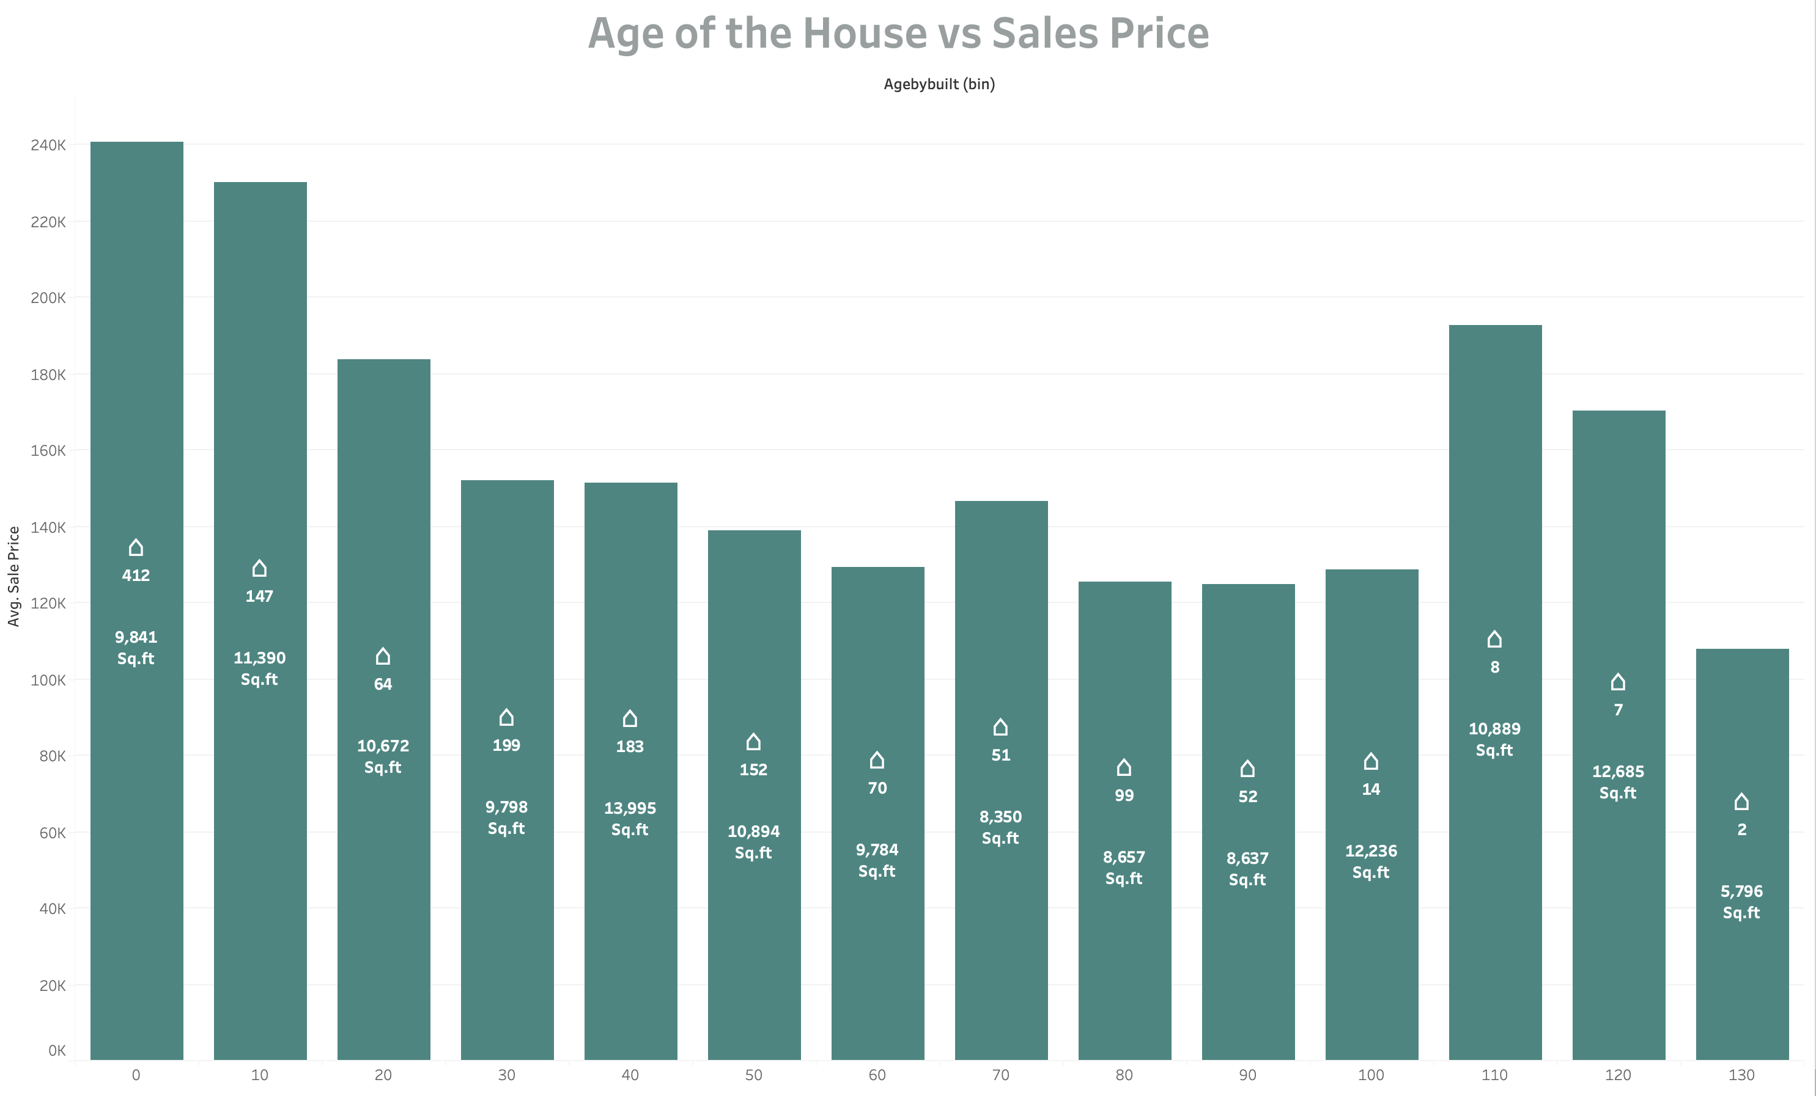
Notes:
Colur change
As you can see, the average sales price of houses decreases as they get older. This is likely due to a number of factors, such as the fact that older houses tend to need more repairs and maintenance, and they may not have the same amenities as newer houses.
The houses that are too old are bigger in size and expensive as well due to historical value. However, houses that are very old,130 yrs commands a lesser price due to small sq ft area of 5796.
From 30 to 100 years the price difference not much btwn the houses.
Similarly, the houses that are relatively newer are expensive too, which is self-explanatory. Even when they have a lesser area they are still most expensive due to newer construction
However the houses that are neither too old nor new have a lower price value.

Slide 14
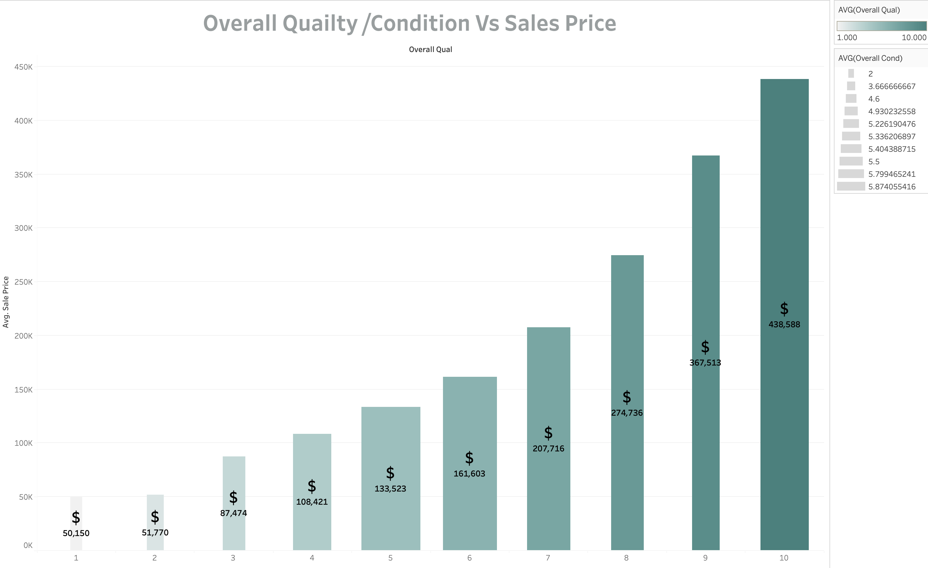
Has the best condition
Notes:
In this graph High quality is depicted in dark green colour and vice versa. High Condition is represented by the bar column width .
Therefore, we see that better the quality, better the condition, higher the sale prices.
But we also observe that people are ready to pay for a high quality estate even if it is in average condition.

Slide 15
Dimension 2
House inside condition

Slide 16
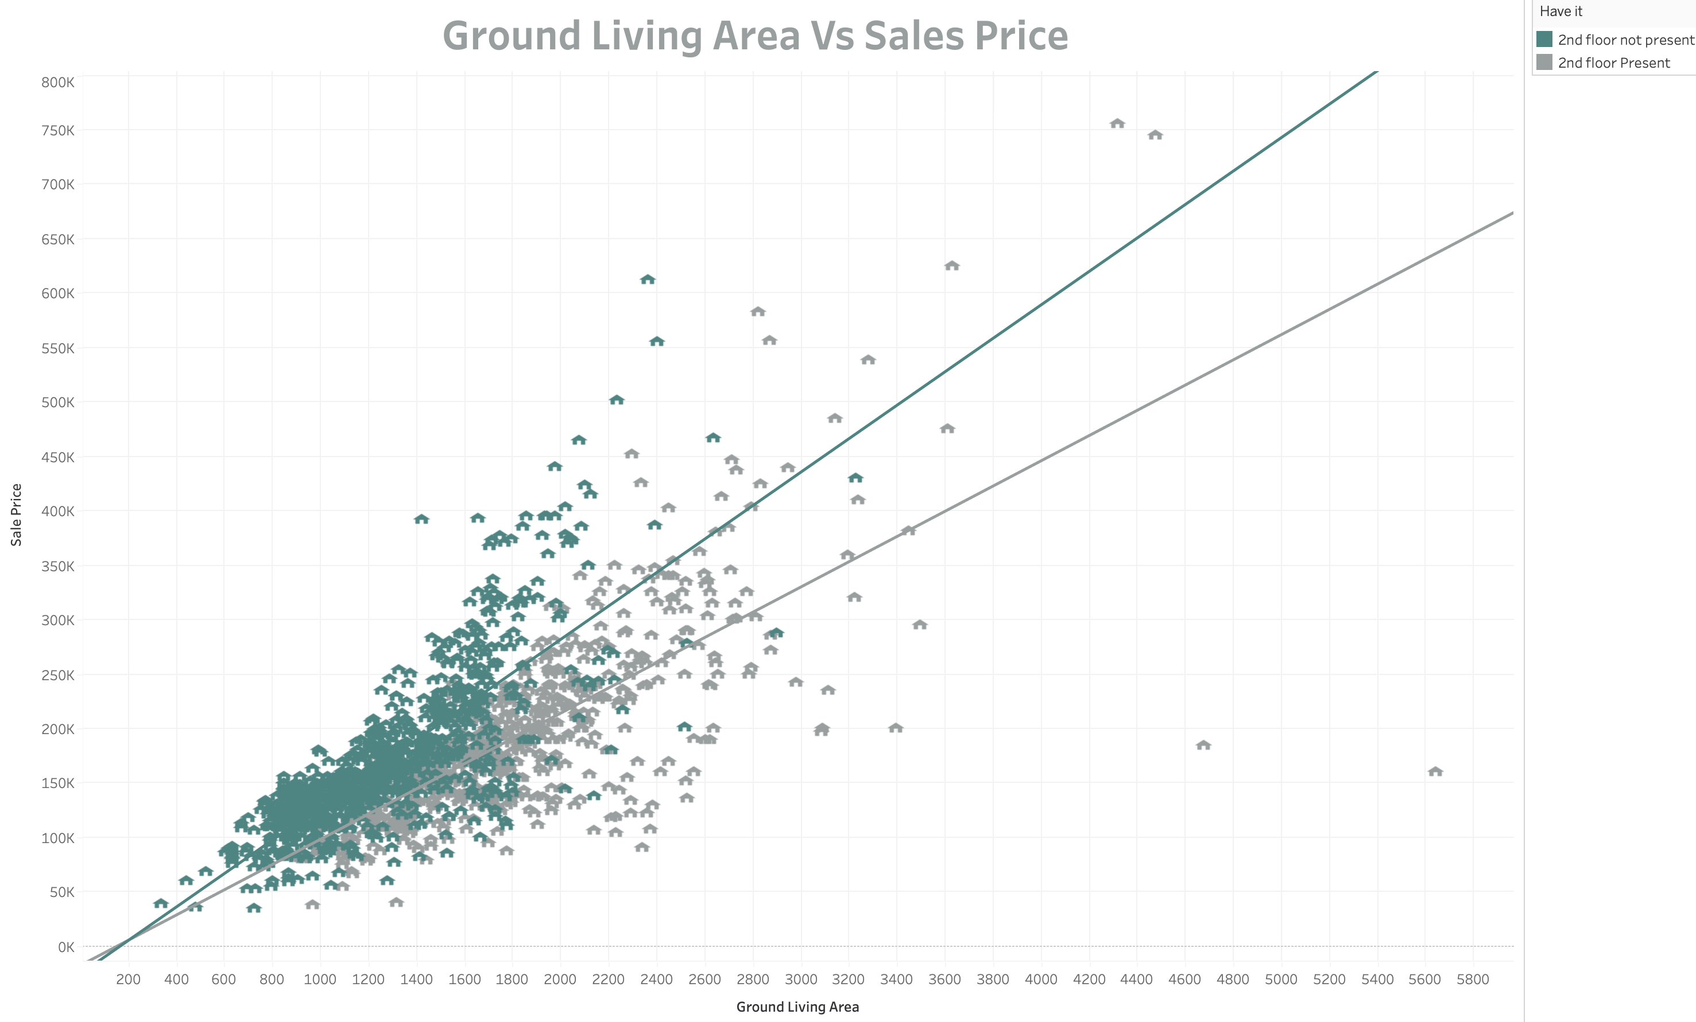
Notes:
In this graph, we observe that houses where 2nd floor is not present i.e depicted in green colour are more expensive than 2nd floor houses.

Slide 17
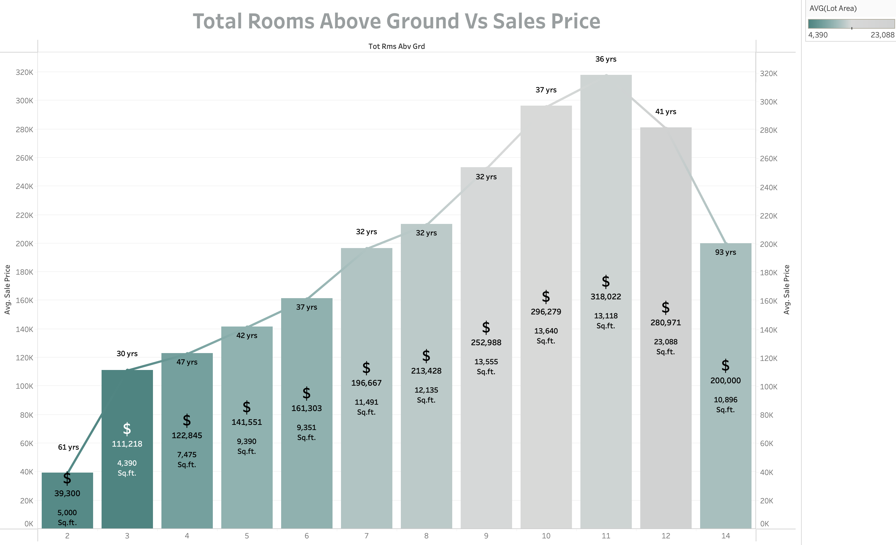
Notes:
With the increase in total rooms, the prices starts to increase as the ground living area is also increasing.
However, it is interesting to note that after 11 rooms, the prices starts to decrease due to increase in age. As we can see that houses with 12 rooms have a lesser price as the houses have an avg. age of 41yrs.
But houses with 14 rooms tend to be even lesser in price because
One - They are 93 yrs old and
Second – the sq ft area is also very less that 10,896. Therefore, this implies that no of rooms are more but room sizes are small.
Houses that have 11 rooms are still higher in price even when they have lesser area in comparison to houses with 10 rooms mainly because they are 1 year new property.
As the houses age, they are lesser in price. We can see this in 11 and 12 rooms.

Slide 18
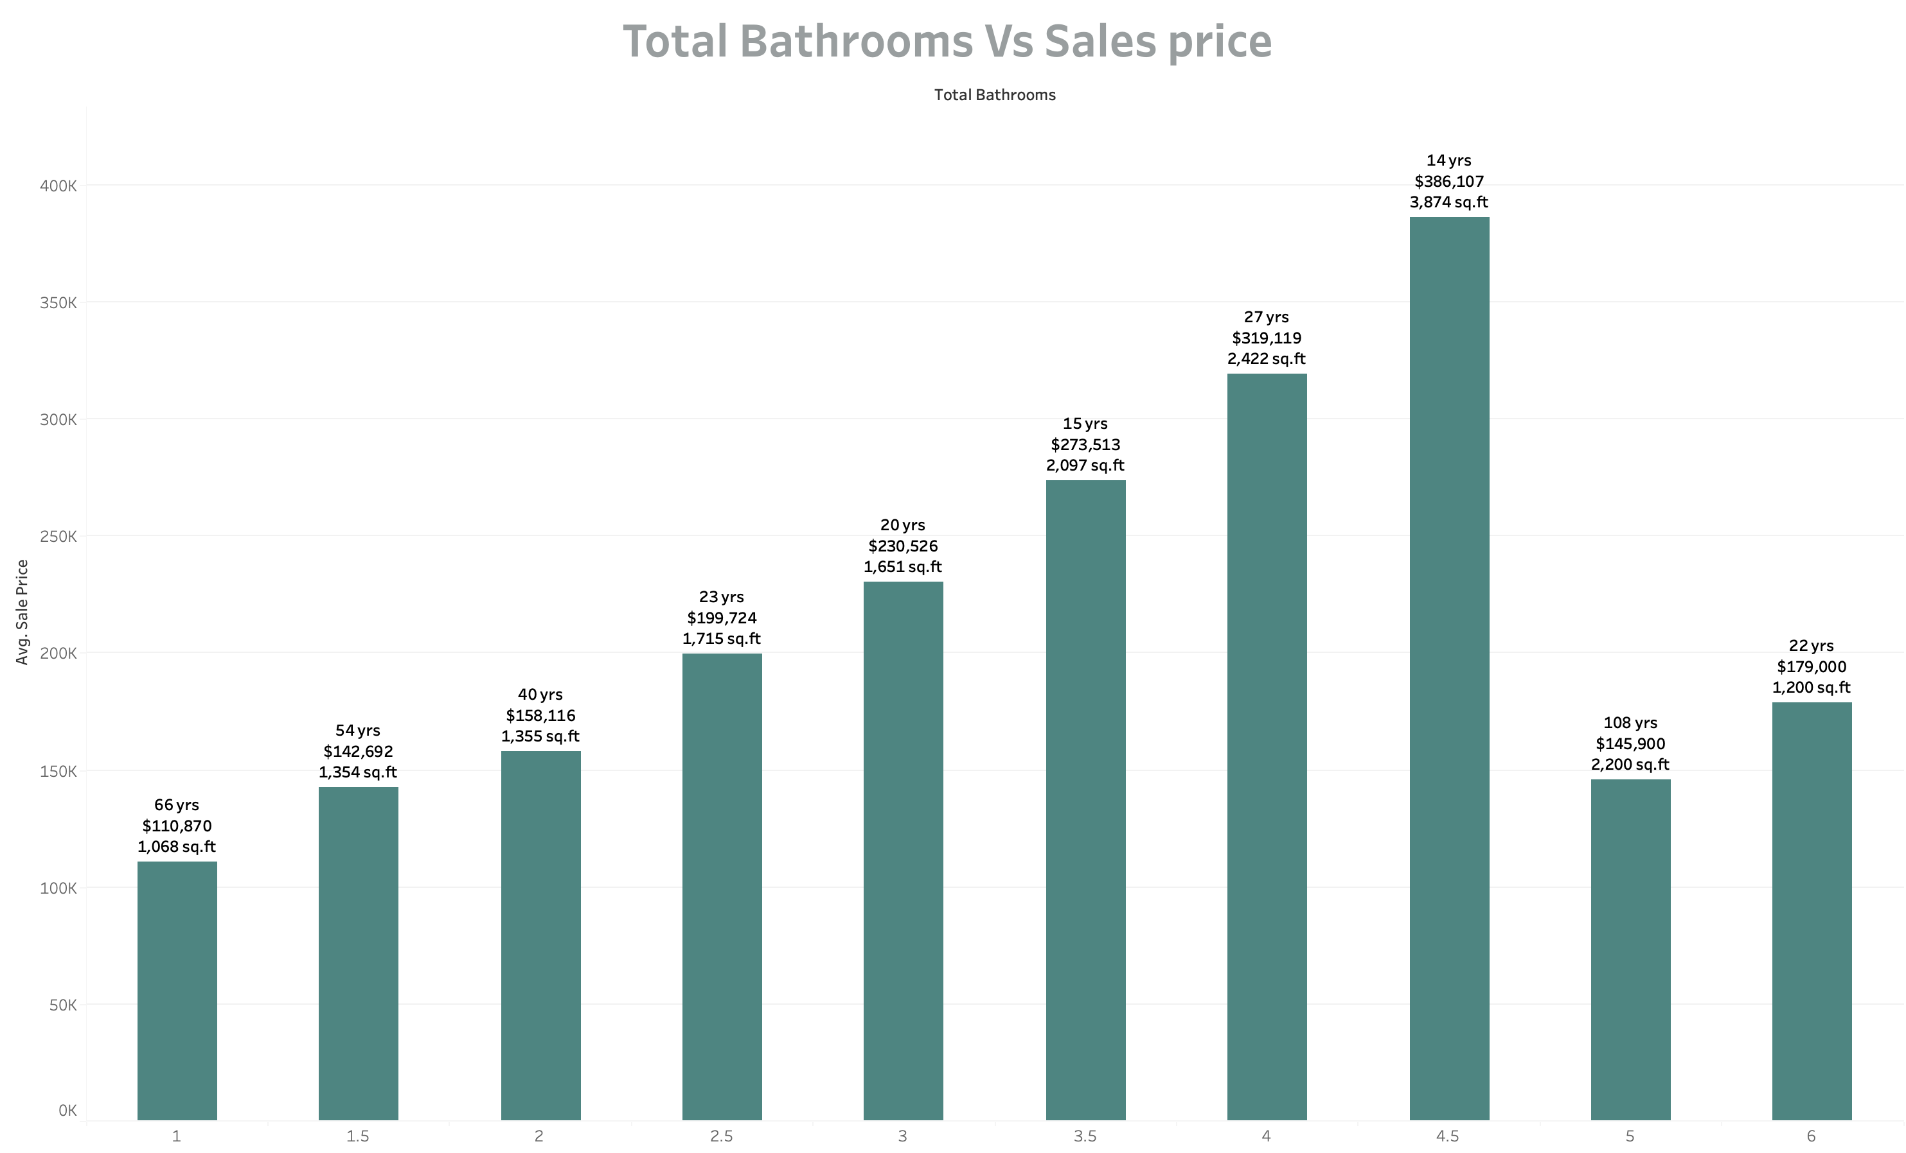
Notes:
In this graph, we see that the average sales price of houses increases with the number of bathrooms in the house, up to a point.
Price Houses with 5 and 6 bathrooms tends to fall. This is mainly because of 2 factors
One – the avg Age of the house is very old i.e. 103 years
Second – Houses with 6 bathrooms are very small in size with an avg ground living area of 1200 sqft.

Slide 19
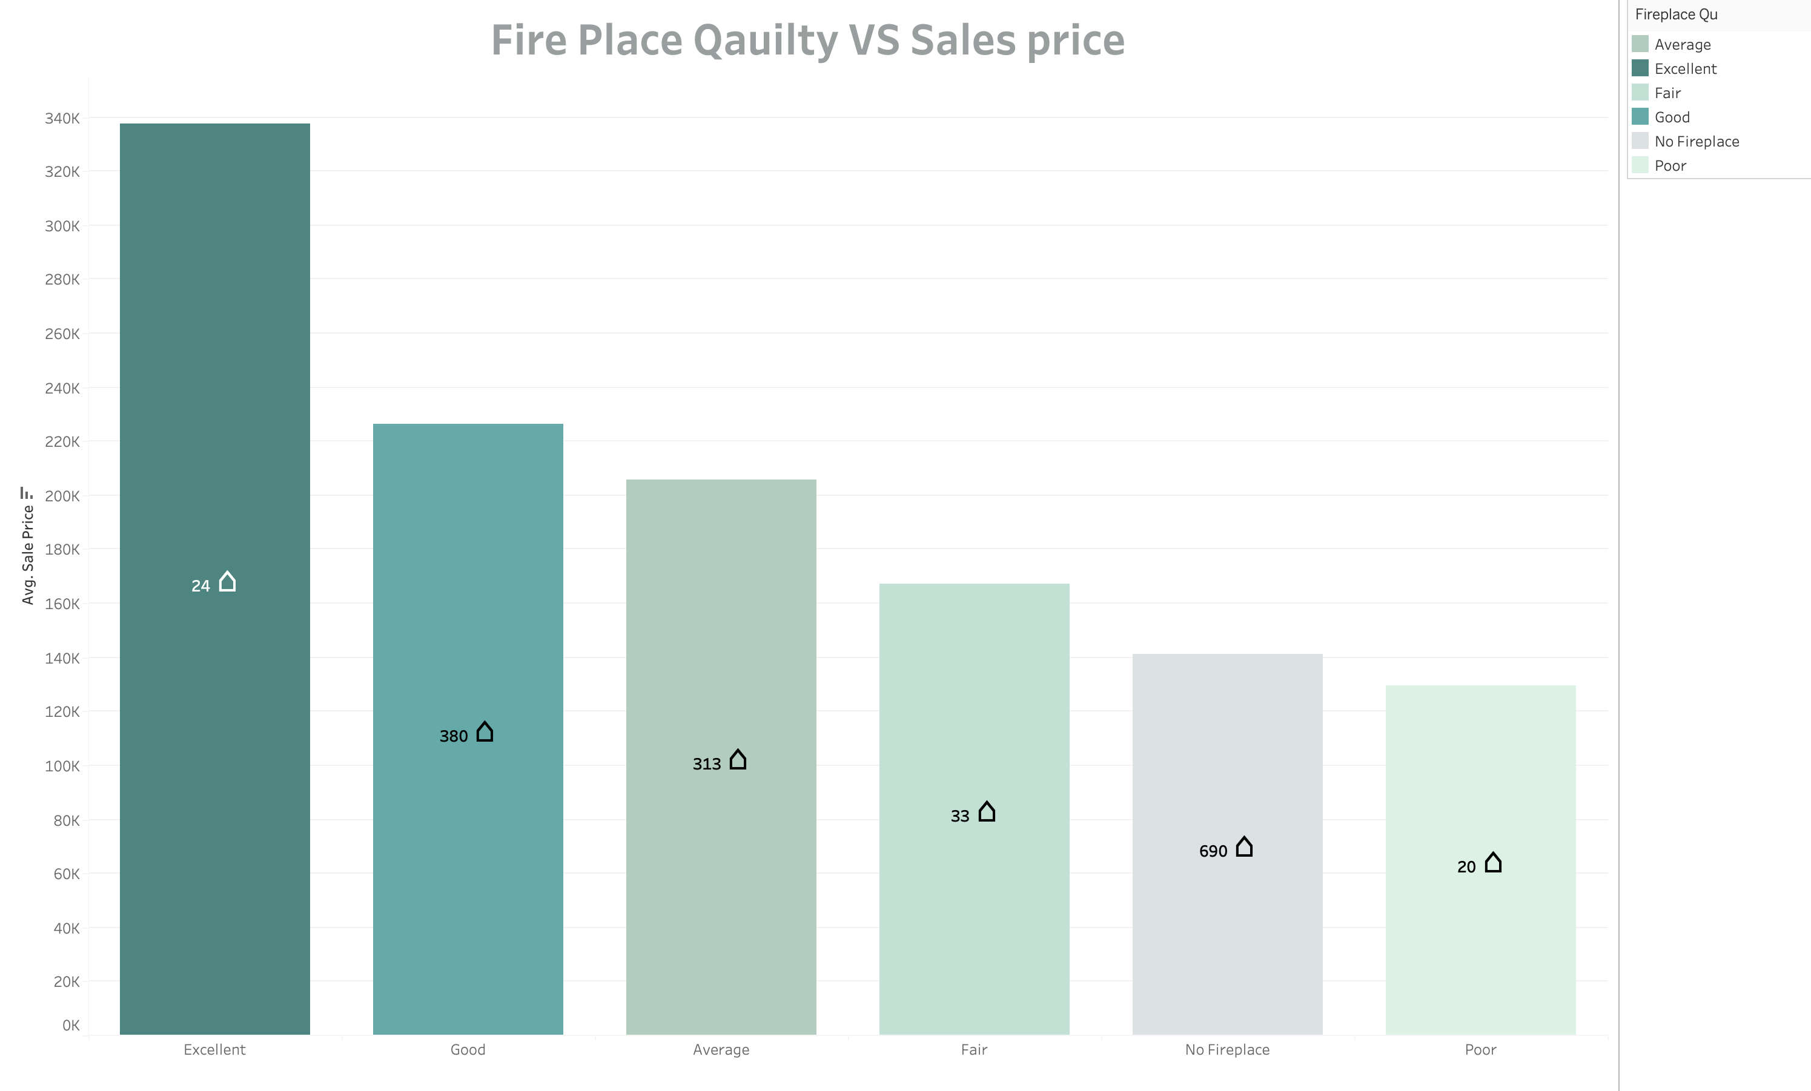
Notes:
We observe, higher the quality, higher the sales price.
However, it is interesting to note that No Fireplace commands a higher price in comparison to a poor fireplace.

Slide 20
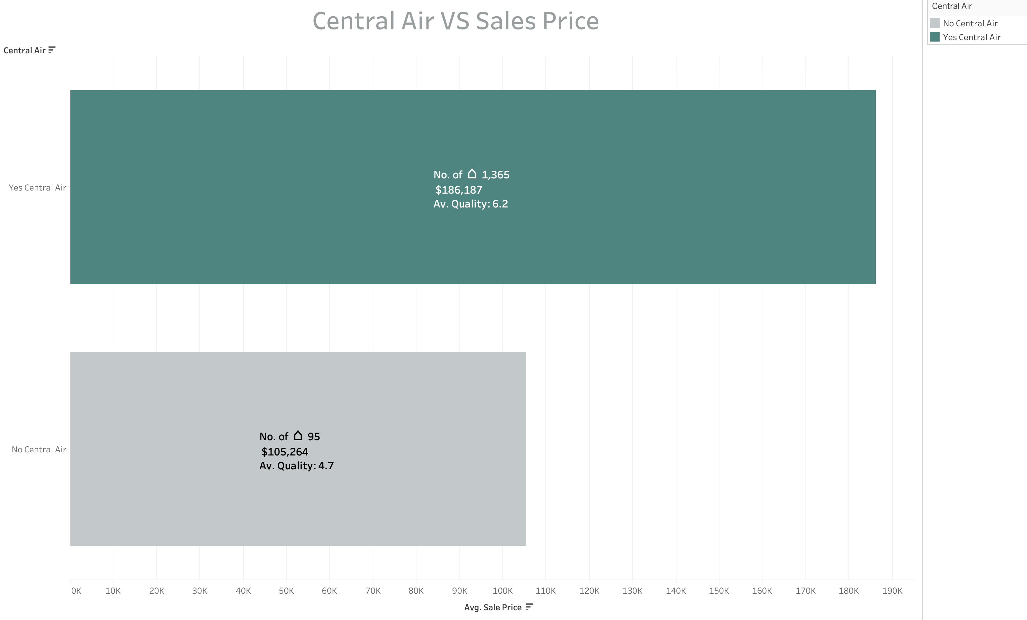
Notes:
We see that houses with Central Air Conditioning have higher prices than houses with no air conditioning.

Slide 21
Dimension 3
House outside condition

Slide 22
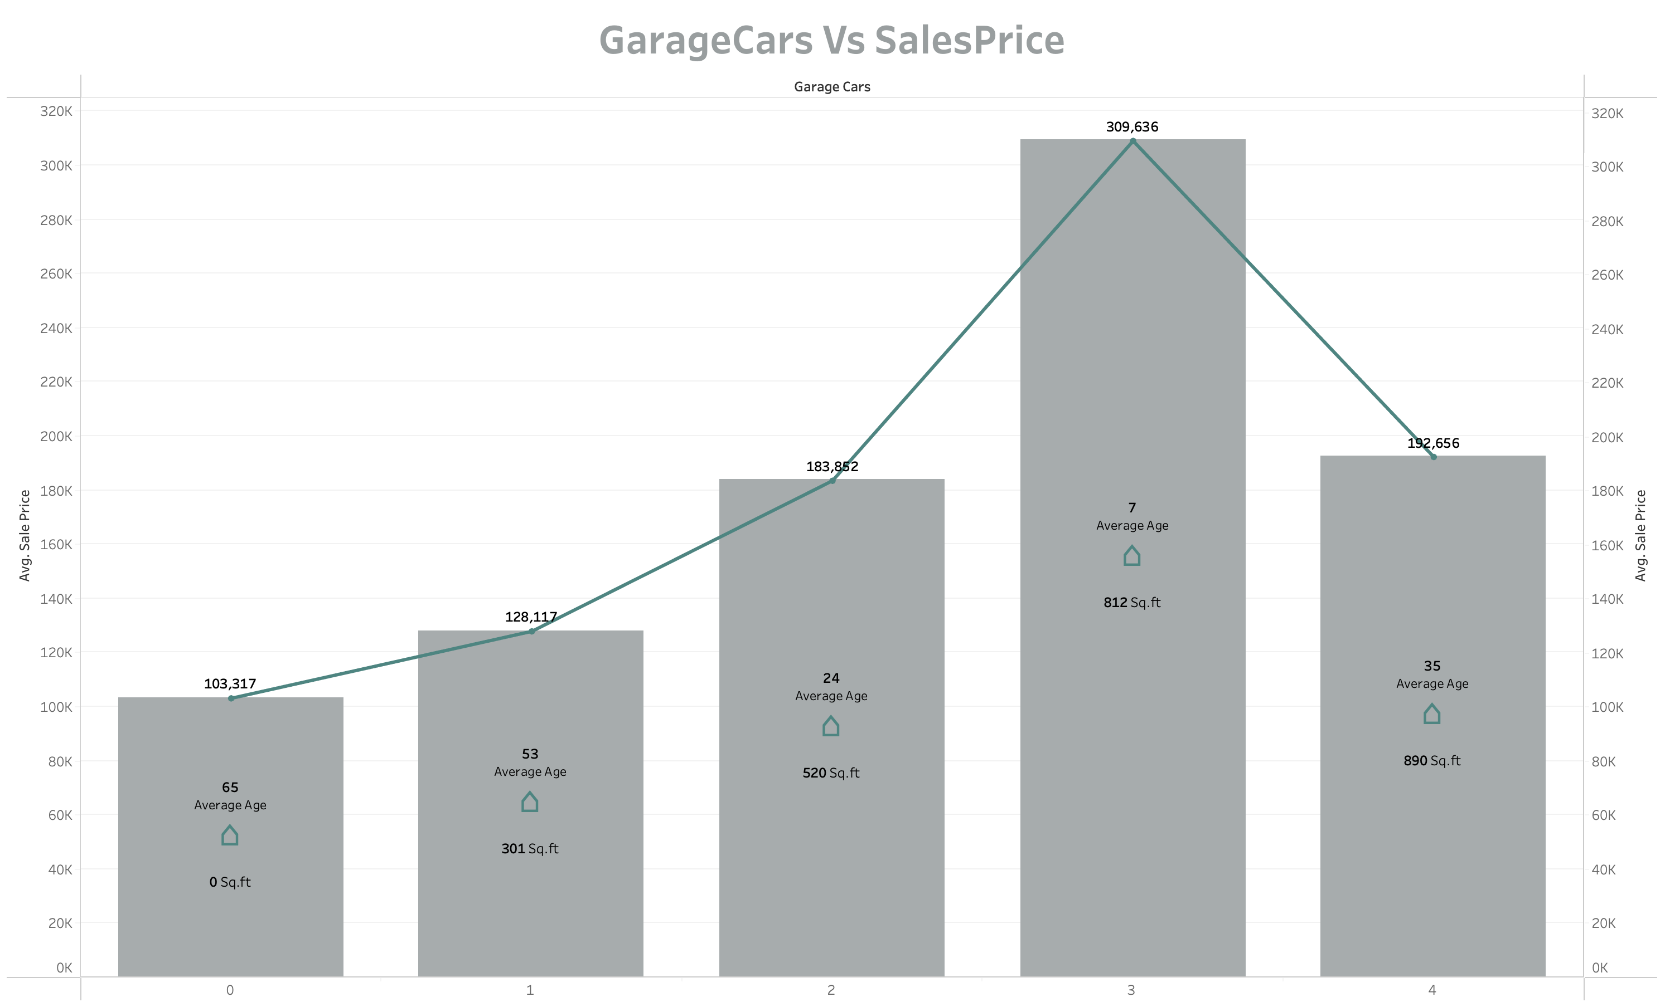
Notes:
The correlation between price and the number of garages is generally positive; however, this trend changes when it comes to properties with four garages. The decrease in price can be attributed to the garage's age, which impacts its value.
Do area in Sqft.

Slide 23
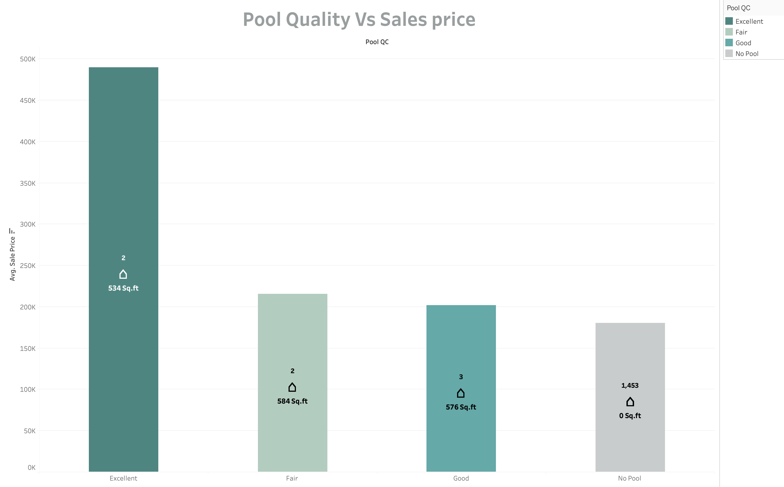
Notes:
We see that majority of the houses do not have a pool and only 7 houses have pool facility in them.
Only 2 houses have excellent pool quality with the highest sale price.
But it is interesting to note that Fair pool quality houses still have higher price that good quality pool houses due to high pool size area.

Slide 24
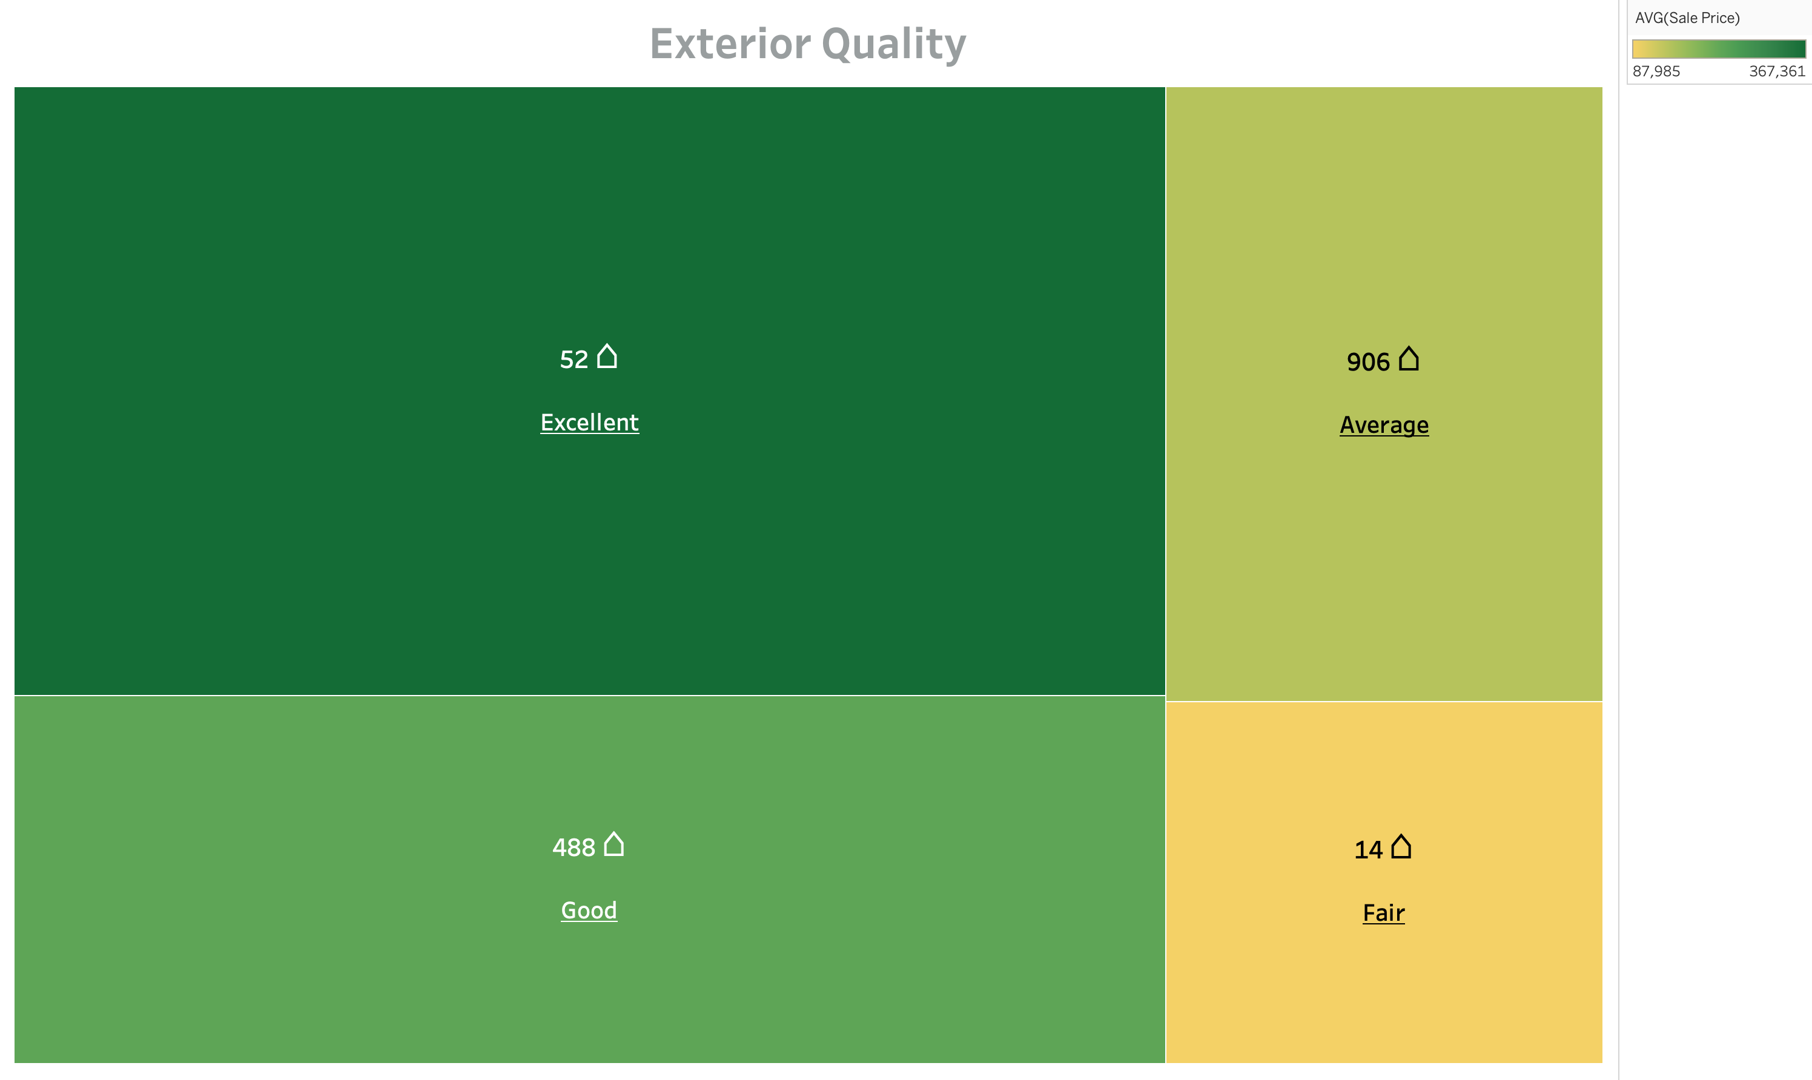
Notes:
excellent Quality houses have highest prices

Slide 25
Dimension 4
House community environment

Slide 26
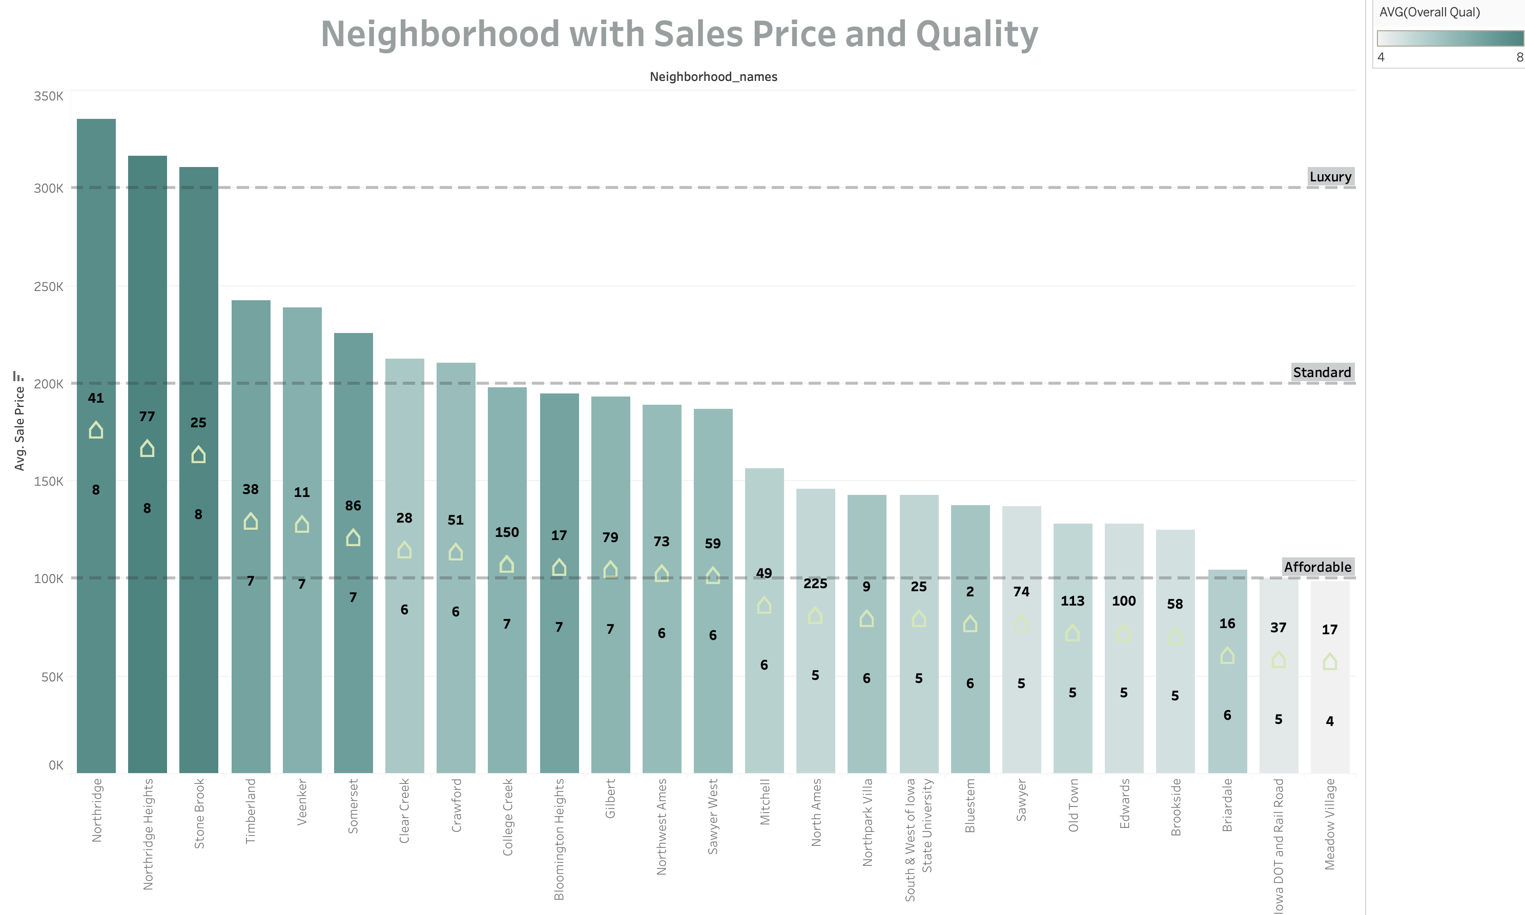
Notes:
The community environment definitely has impacts on the sale price of a house.
In this graph, high quality is represented in dark green colour and as the colour fades, quality also diminishes.
We observe that Noridge, Noridge heights and Stone Brook are luxury neighbourhoods with the highest quality and meadow village has the least sale prices with lowest quality and the most affordable estate.

Slide 27
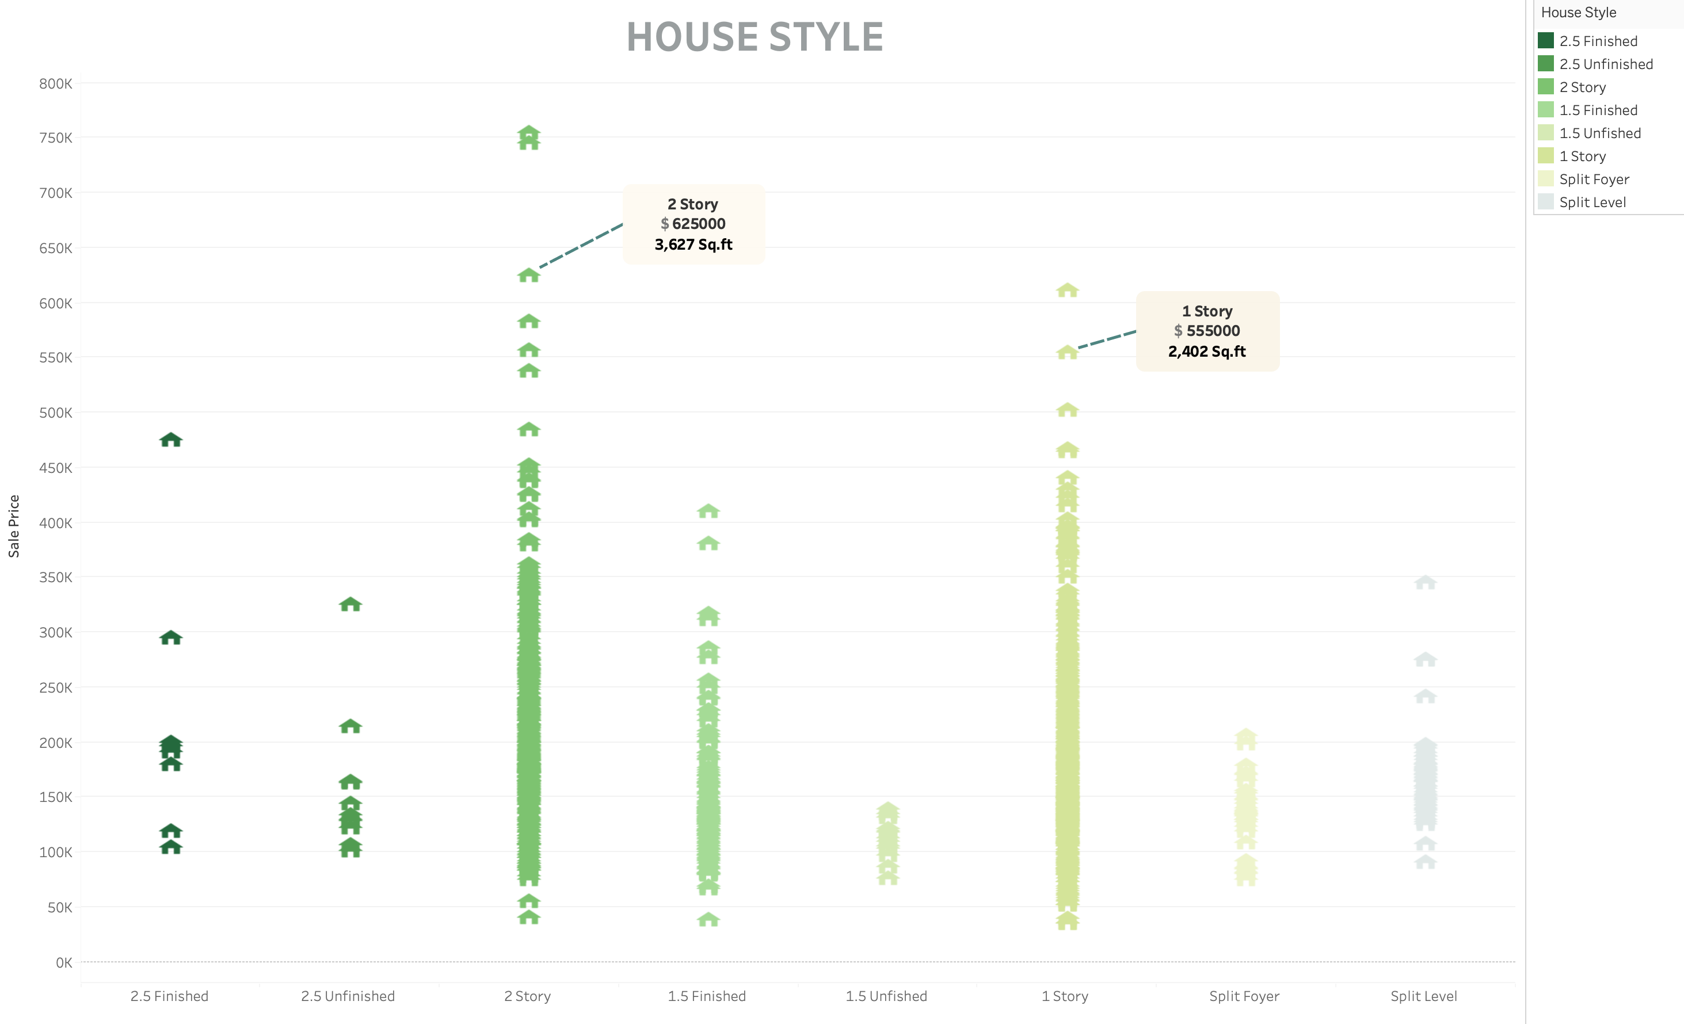

Slide 28
Analysis Part 2
Model Testing :
Predicting House Prices

Slide 29
The purpose is to Predict House Prices with Least Error
Trained 5 models, which are proven to be effective, to predict prices based on Houses information
Over 80 Input variables:
Information about houses
Output Variable :
Housing Sales Price
Lasso Regression
Ridge Regression
Decision Tree
Linear Regression
Random Forest
Overall Quality
Above Grade – Living Area
Size of the Garage
Neighbourhood
Lot Size in square feet

Slide 30
A glance at the dataset
Attributes : 80 Independent and 1 Dependent
Data Type :
Object - 43
Integer - 35
Float - 3
House Information
General shape of property
Neighbourhood Area
Street
Material Used
Utilities/ Facilities
Room Dimension
Quality
Original construction date
Remodel date
Alley
Neighborhood
Exterior covering on house
Roof
Material
Type of foundation
Type of utilities available
Type of heating
Electrical system
Lot size in square feet
First Floor square feet
Second floor square feet
Heating quality and condition
Kitchen quality
Garage quality
Data Categorization

Slide 31
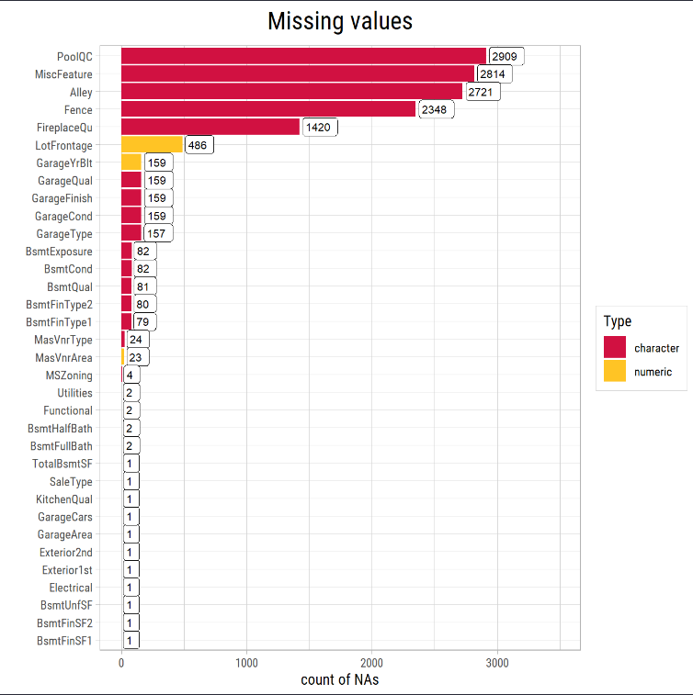
Data Cleaning and Transformation
Explorating dataset is the foundation of the following pre-processing and modelling
Now, let’s combine training and testing into a single dataset and take a look at the count of missing values
Here are the dimensions of the training and testing sets respectively
Training data has:
1460 entries and 75 features
Where as our Test data has :
1459 entrie and 74 features
Notes:
Remove codes and add values

Slide 32
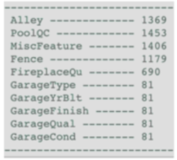
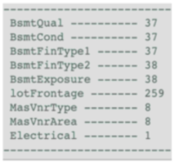
Missing Value Imputation of Train dataset
Pseudo Missing Value
No Alley Access
No Pool
All covered
No Fence
No Fireplace
No garage
Imputed with NA
Features
BsmtExposure BsmtFinType2
Groups
Imputation
Mode
LotFrontage
MasVnrType MasVnrArea
Electrical
Neighborhood YearBuilt
Neighborhood
Neighborhood YearBuilt
Neighborhood
Median
Mode
Sbkr
Real Missing Value
37 No Basement
Id 949 misses Exposure
ID333 misses FinType2
259 misses Lot Frontage
8 miss MasVnrtyoe
8 miss MasVnrArea
1 Electrical

Slide 33
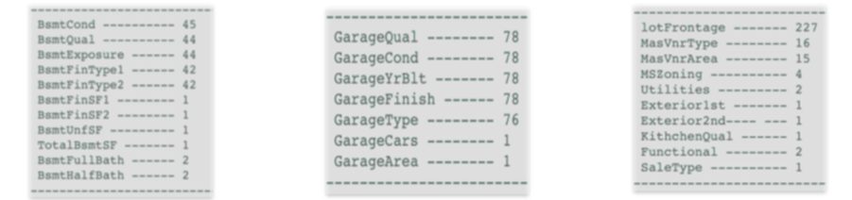
Missing Value Imputation of Future dataset
Id 2218
Id 2219
Id 2349
Wrong inputs
No Basment
Id 2127
Id 2127
Wrong inputs
No Garage
Lot Frontge
MasVnrTypeMasVnrArea
MsZoning
Utilities
Exterior
Kitchen qual
Functional
Saletype
Median
None
0
None
AllPub
VinylsD
TA
Mod
Wo

Slide 34
Columns Dropped from Dataset
Column1 | Correlation | Column2 | Dropped Column | Correlation with SalesPrice
FinishedBsmtAreaSF | 0.94 | BsmtFinSF1 | FinishedBsmtAreaSF | 0.39>0.37
Total BathBasement | 0.97 | BsmtFullBath | TotalBathBasement | 0.23>0.22
Total BathrromsAbove Grade | 0.92 | FullBath | FullBath | 0.6>0.56
GarageCars | 0.88 | GarageArea | GarageArea | 0.64>0.62
MSSubClass | - 0.08 | OA1 | 0.76
OverallCond | - 0.08 | TotalRooms | .50
Id | 0.2 | Heating | .2
HalfBath | 0.28 | Functional | .15
TotalBathBasement | 0.2 | RoofMatl | 0.18

Slide 35
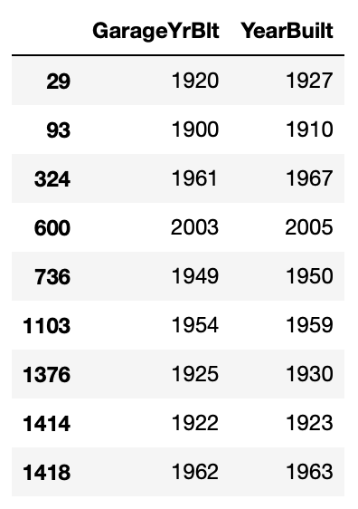
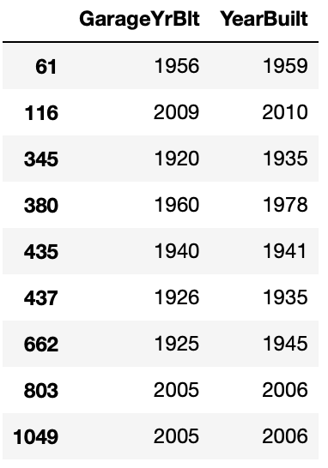
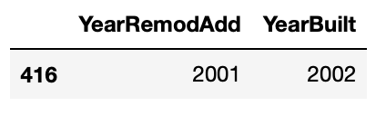
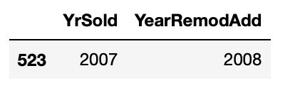
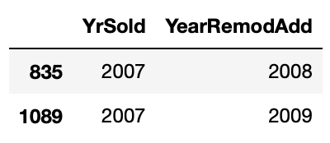
Data Cleaning and Transformation
We will visualize features of the complete dataset and create a data cleaning pipeline
Fixing Data Errors
YearRemodAdd should not be earlier than YearBuilt: 1 record to be fixed
YrSold should not be earlier than YearRemodAdd: 3 records to be fixed
GarageYrBlt should not be earlier than YearBuilt: 18 records to be fixed
In test data
In Training data

Slide 36
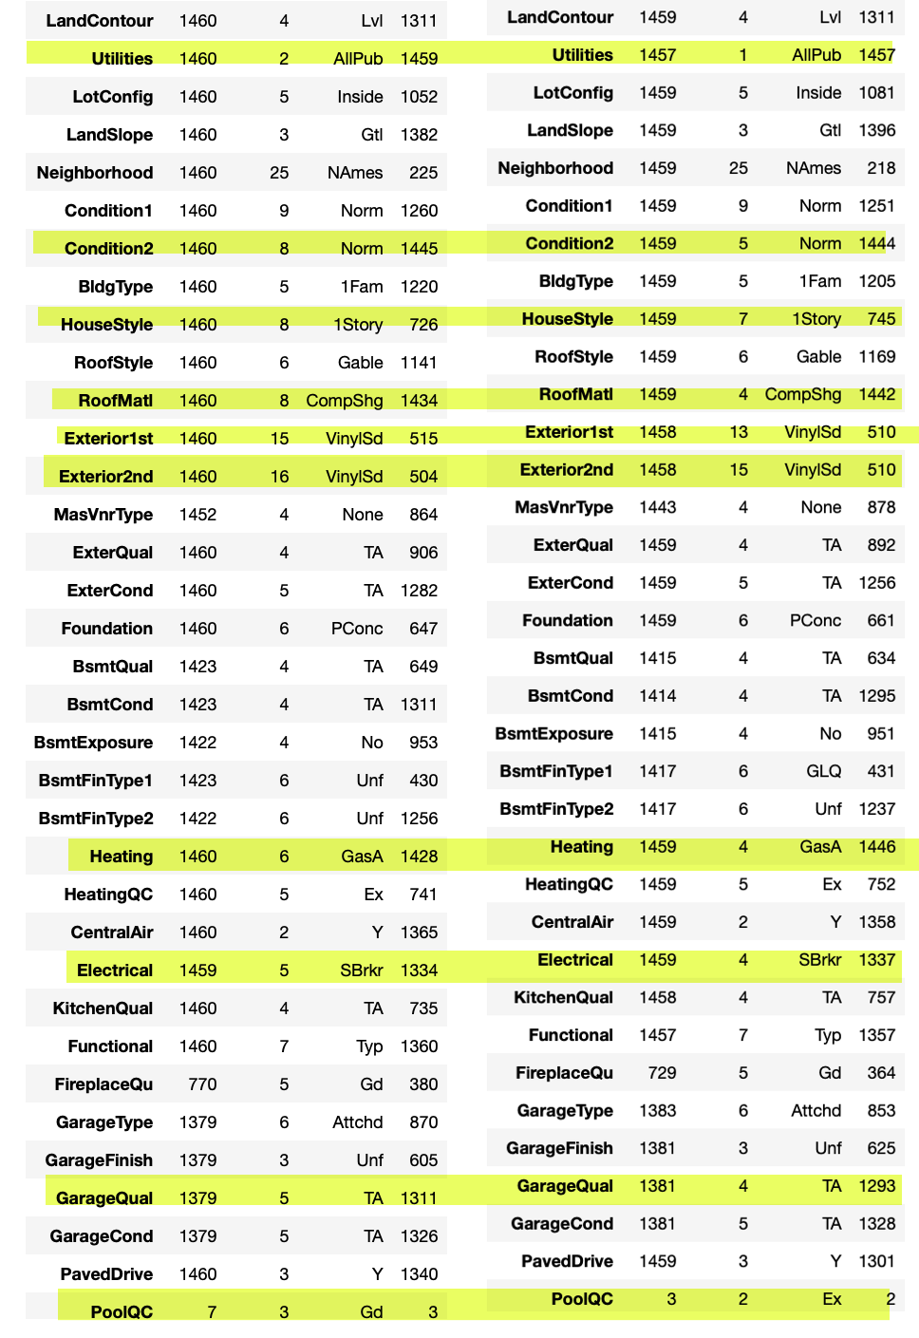
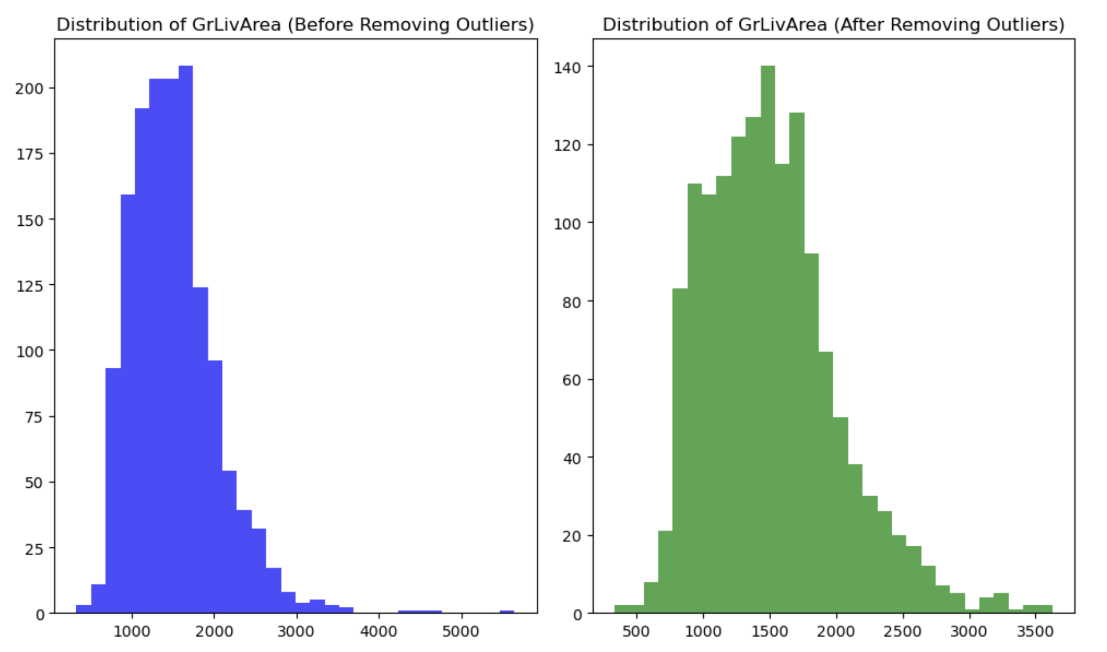
Data Cleaning and Transformation
Imputing unique values , so after one hot encoding both the data set should have equal features
Utilities
Condition2
HouseStyle
RoofMatl
Exterior1st
Exterior2nd
Heating
Electrical
GarageQual
PoolQC
1
3
1
4
2
1
1
1
1
1
Notes:
Remove code and add info.

Slide 37
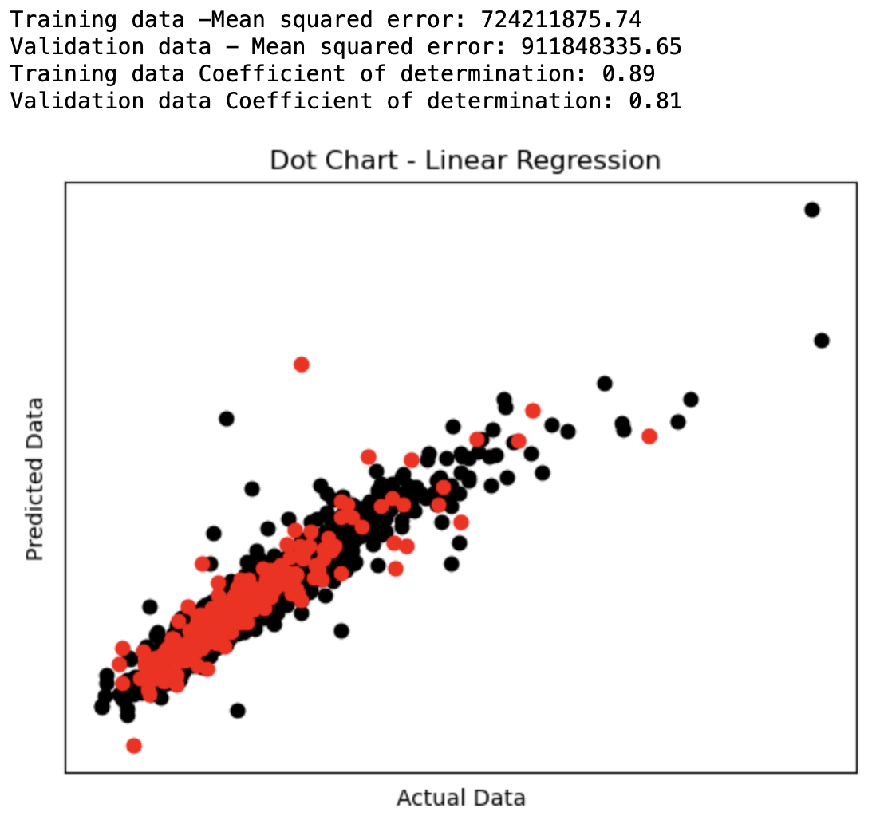
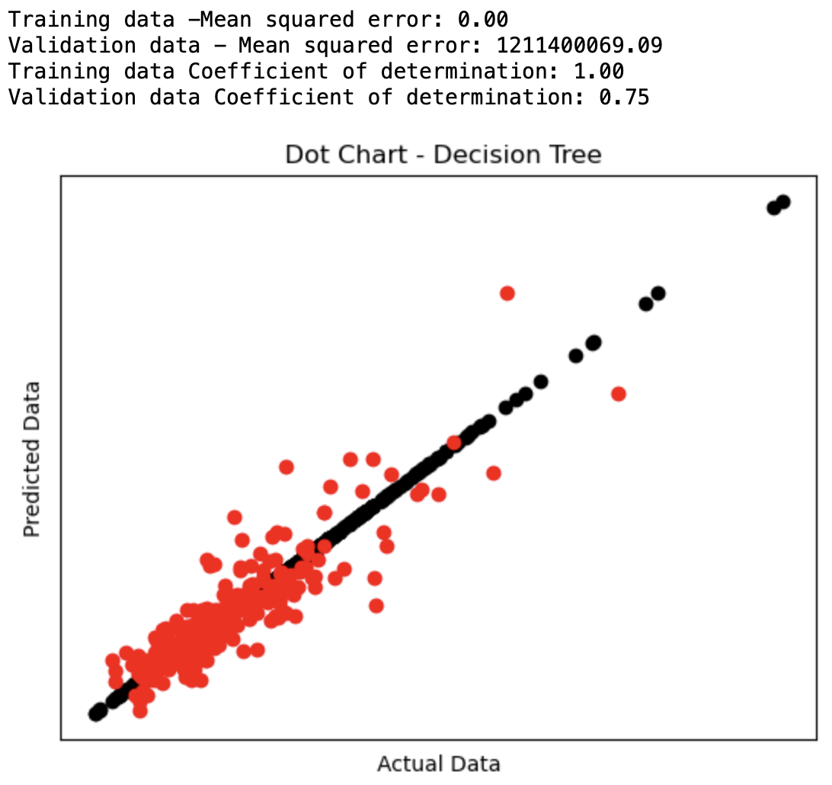
Model Training

Slide 38
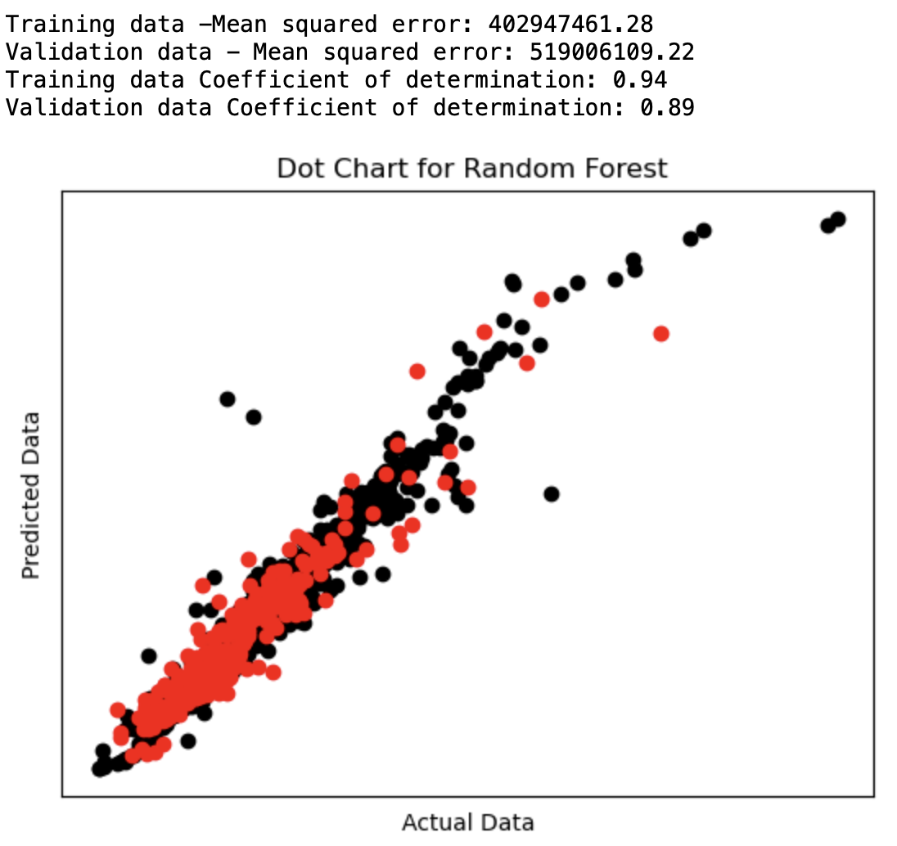
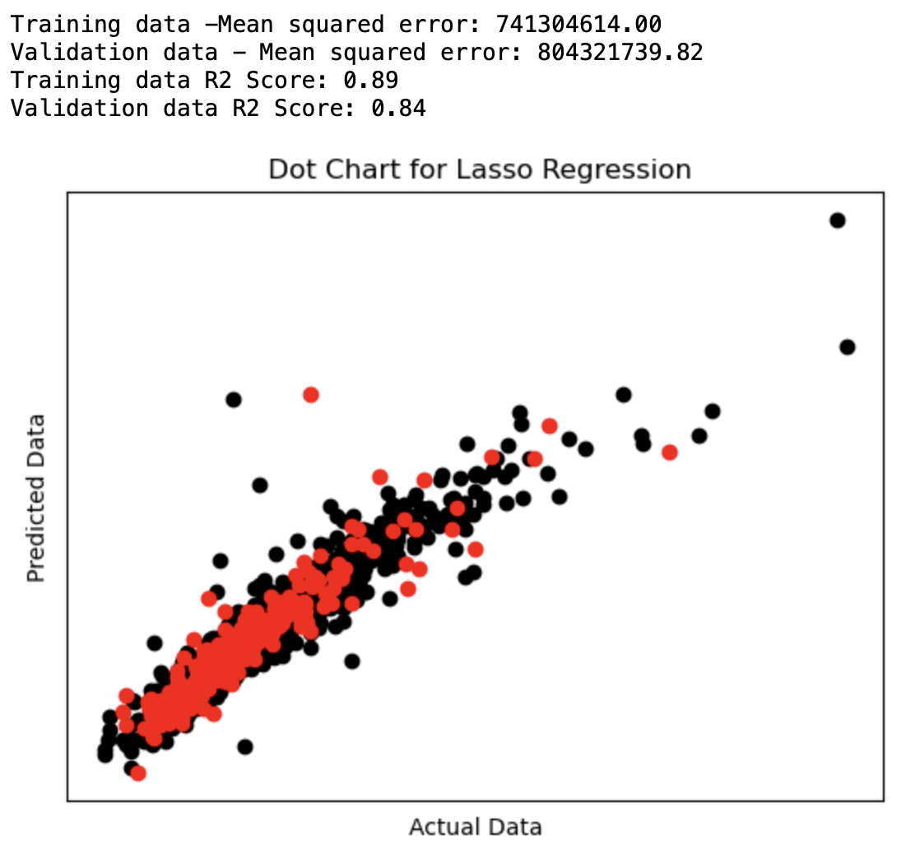
Model Training

Slide 39
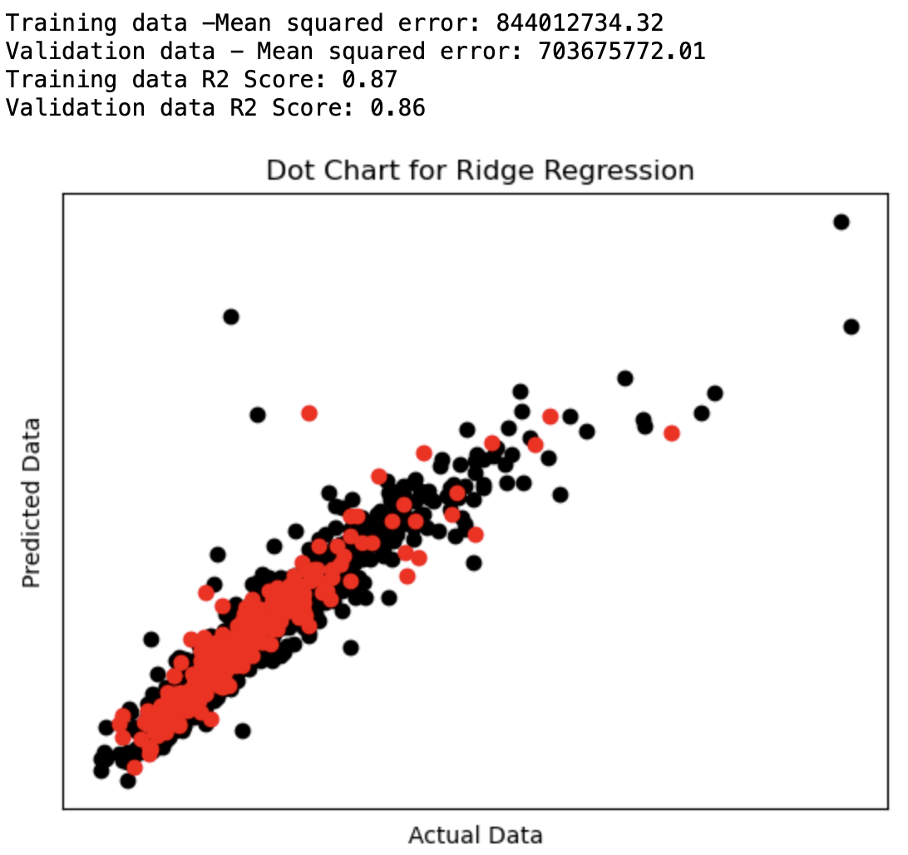
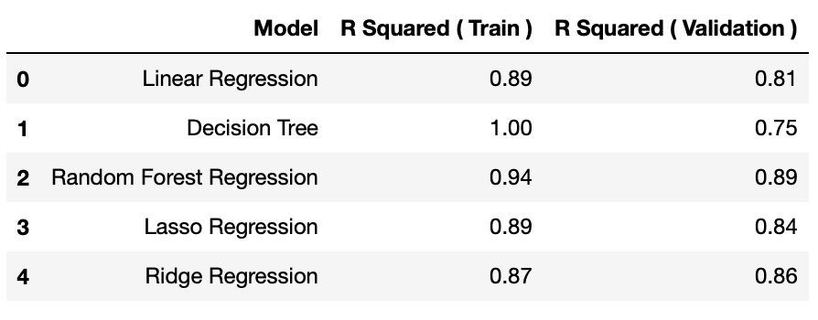
Model Training
Ridge regression is the best model here so going
forward with it for prediction.

Slide 40
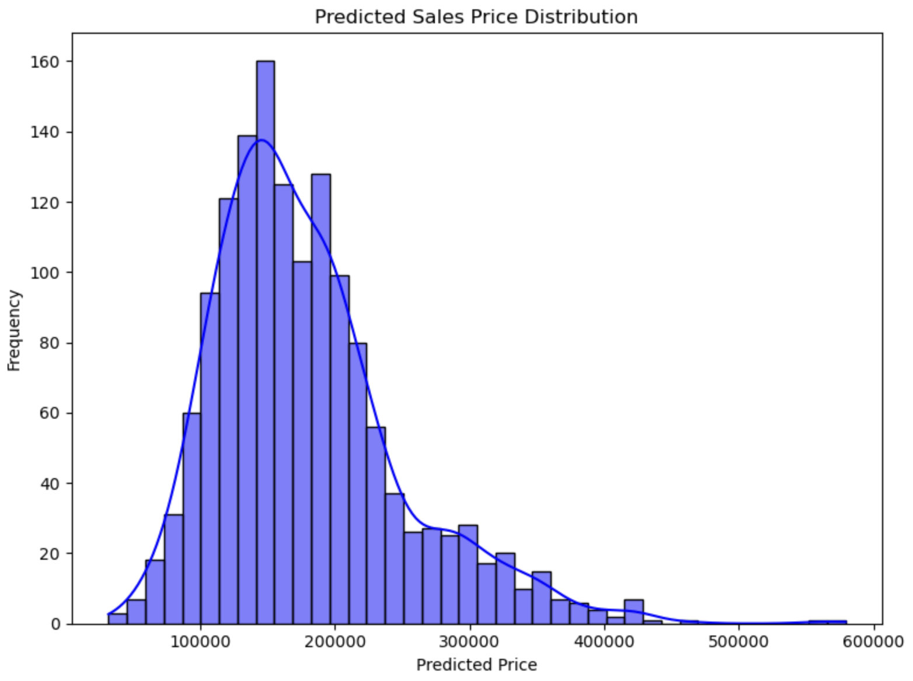
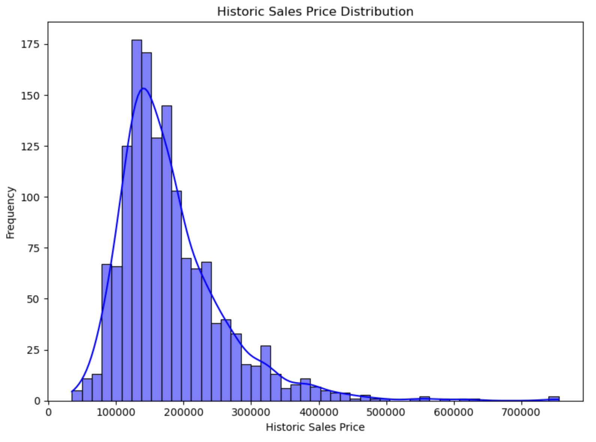
Comparing Data after Prediction

Slide 41
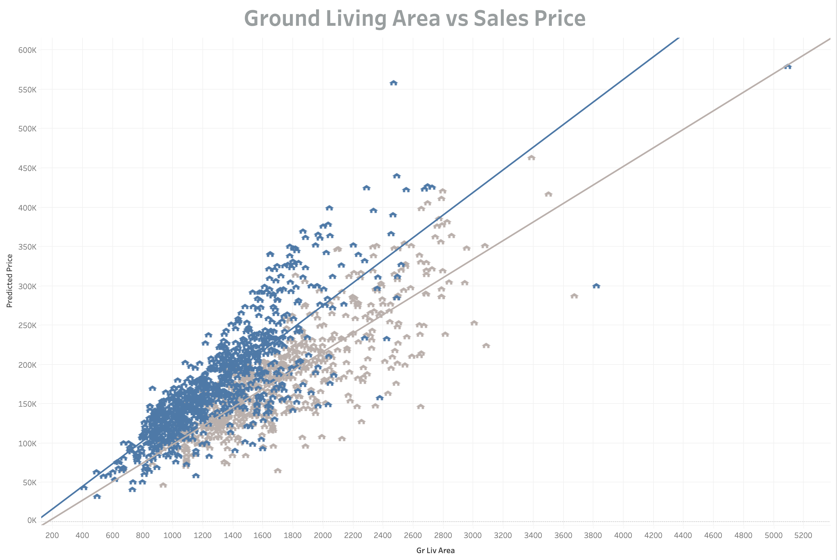
Comparing Data after Prediction

Slide 42
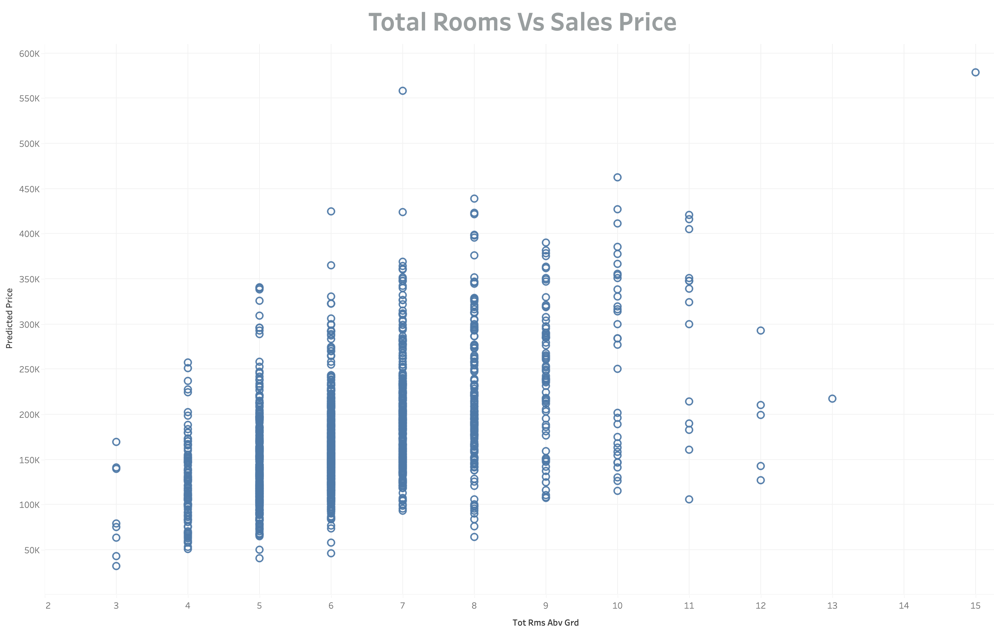
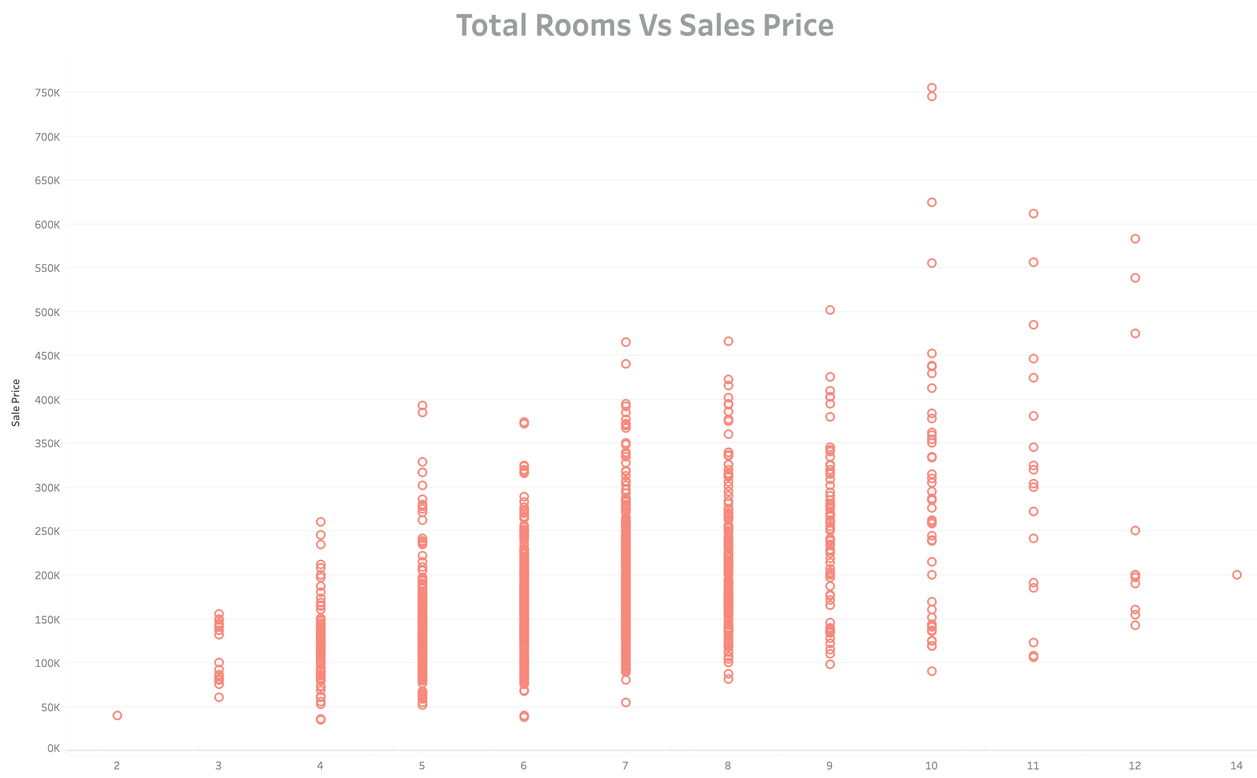
Comparing Data after Prediction
Notes:
Do more visualizations like historic data.

Slide 43
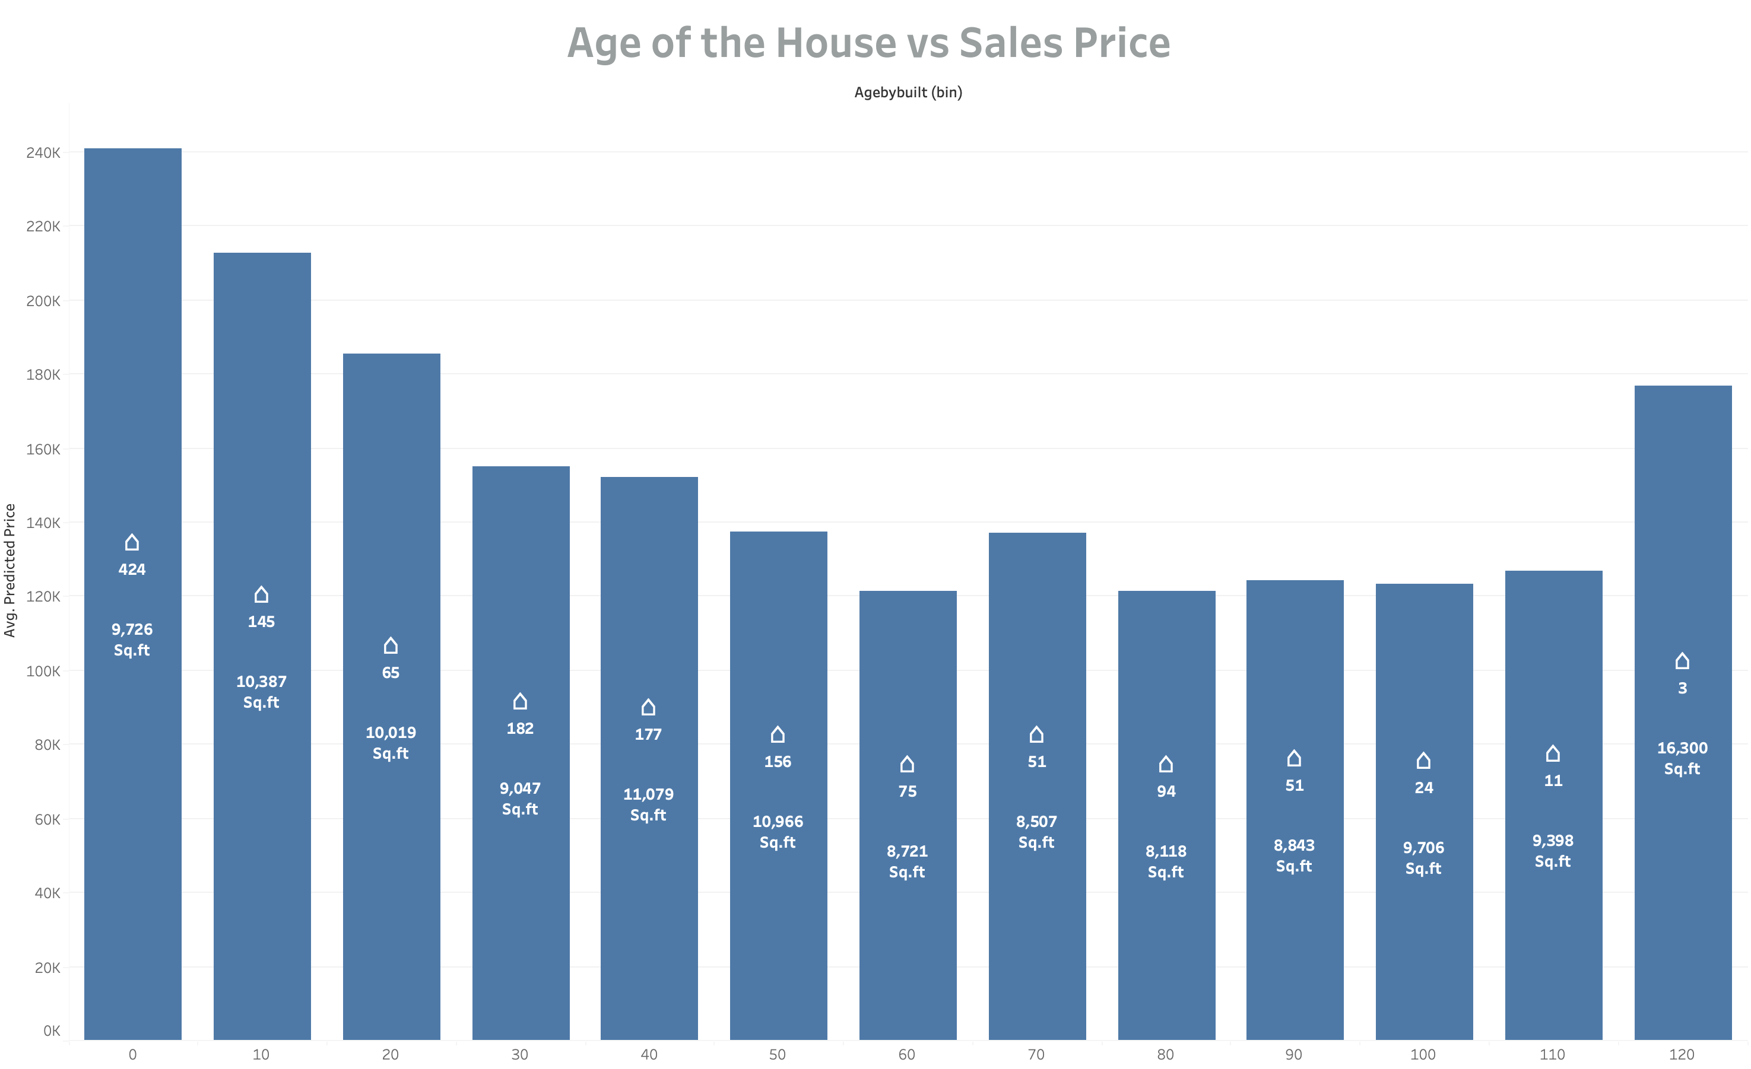

Slide 44
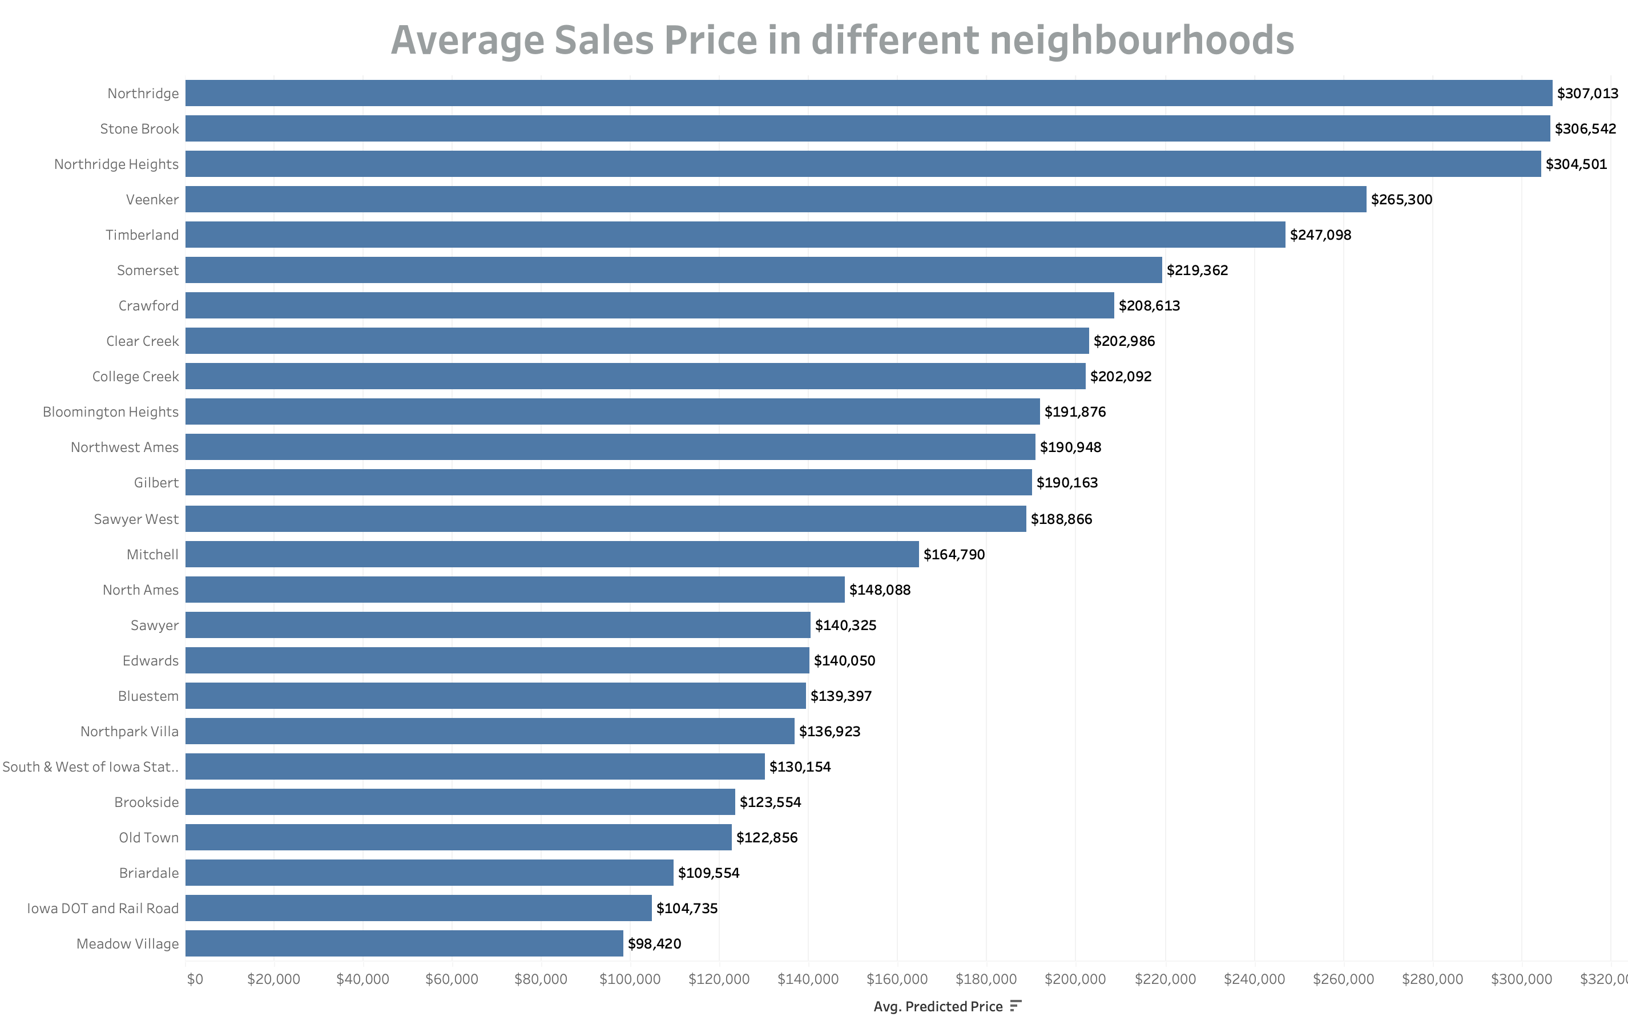
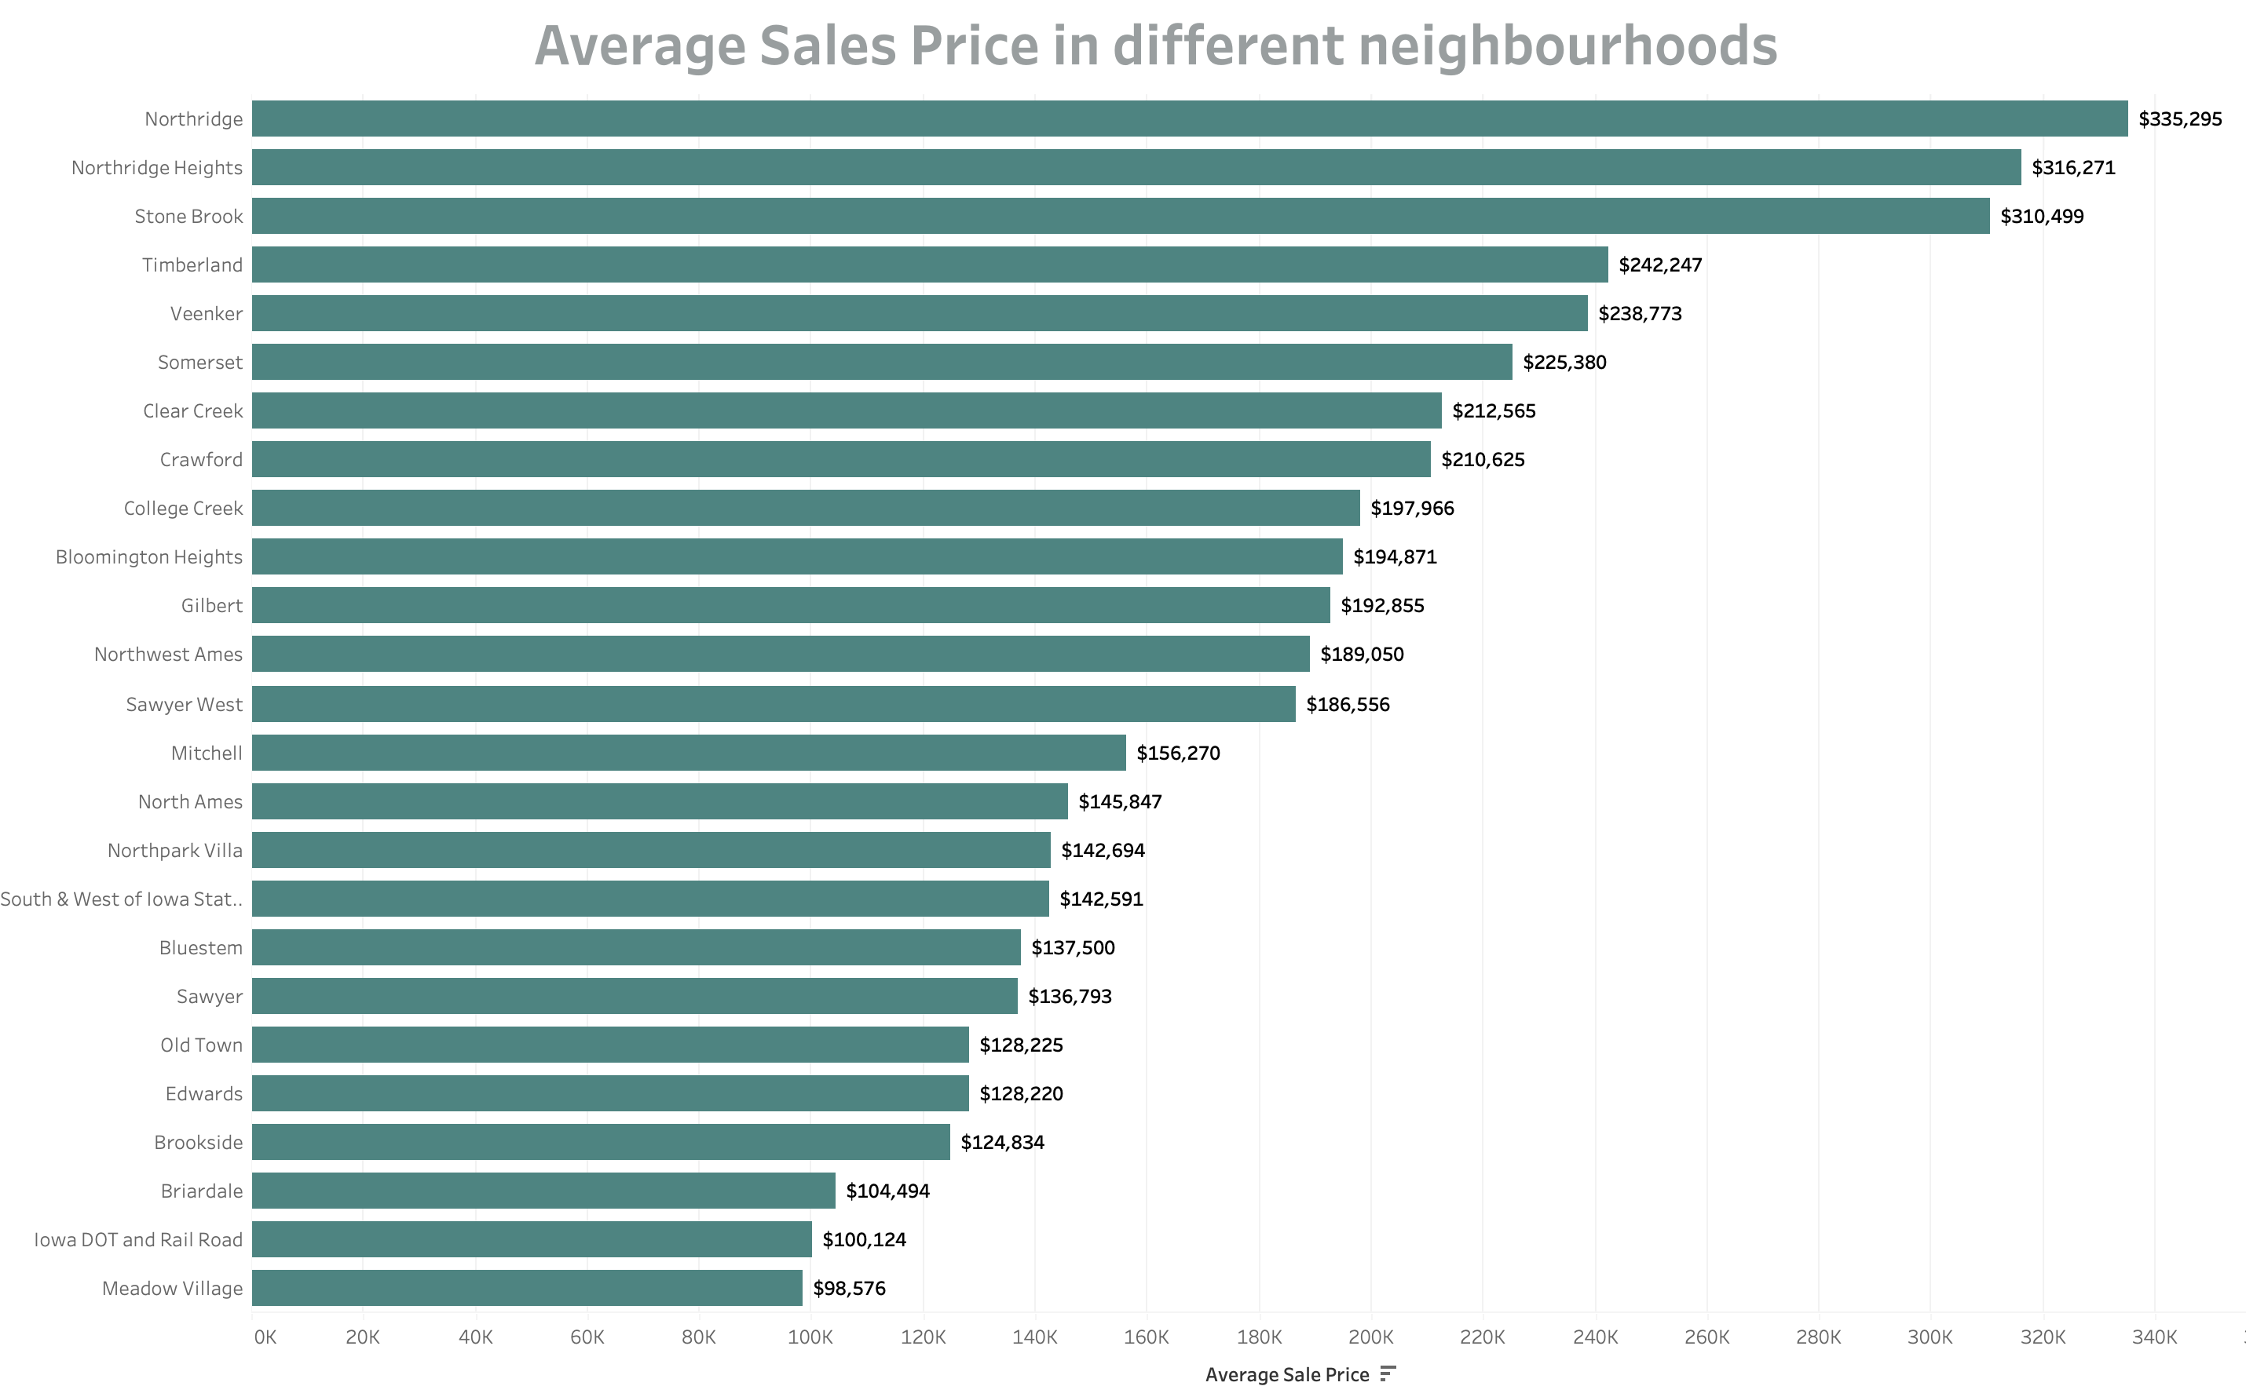
Comparing Data after Prediction

Slide 45
Conclusion
Ridge model achieved an average error of 4% within the most common price range from $50,000 to $20,0000.
Feature Importance
The top 5 predictor variables given by the feature importance score of gradient boosting machine are:
TotalSF - Featured variable: Total Squared Feet of the house;
OverallQual: Rates the overall material and finish of the house;
GrLivArea: Above ground living area square feet;
YearBuilt: Original construction date;
KitchenQual: Kitchen quality;
Notes:
XG boost

Slide 46
Thank You

